Slide 1
8 Sports Words

Slide 2
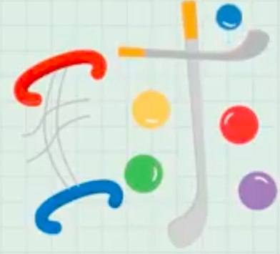
qiú
球

Slide 3
zú qiú
足 球

Slide 4
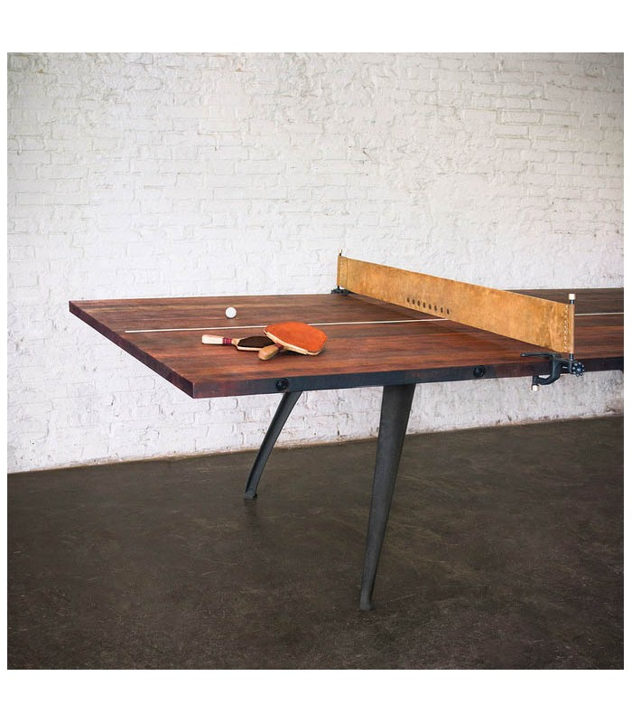
乒 乓 球
pīng pāng qiú
^{球}
乒
乓

Slide 5
网 球
wǎng qiú

Slide 6
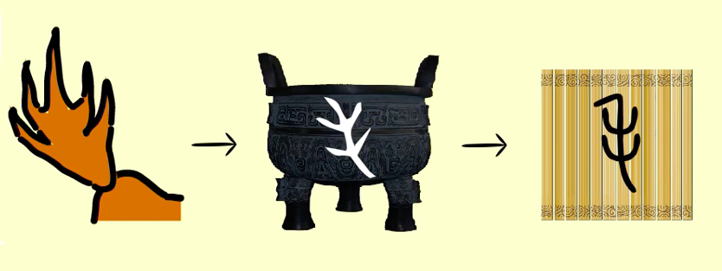
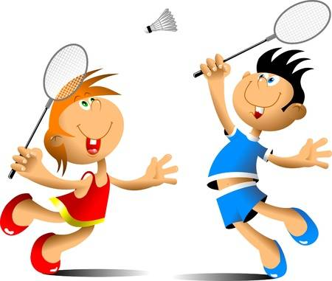
羽 毛 球
yǔ máo qiú

Slide 7
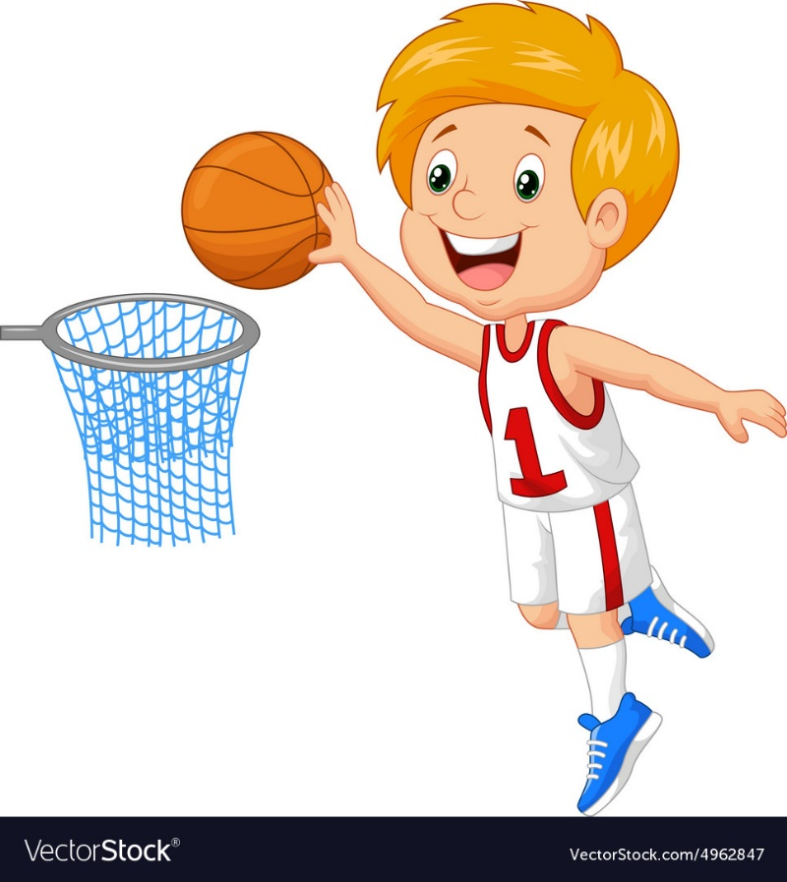
篮 球
lán qiú

Slide 8
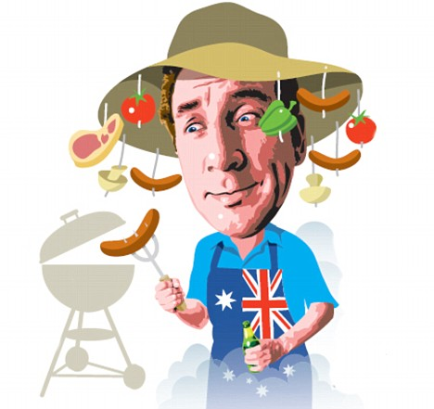
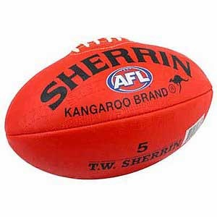
澳 式 足 球
Australian style soccer!
That is AFL!
+
=
Ào shì zú qiú
Ào shì zú qiú
澳式足球
Aussie style soccer
AFL

Slide 9
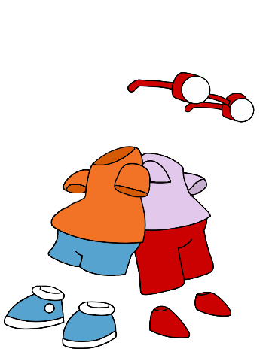
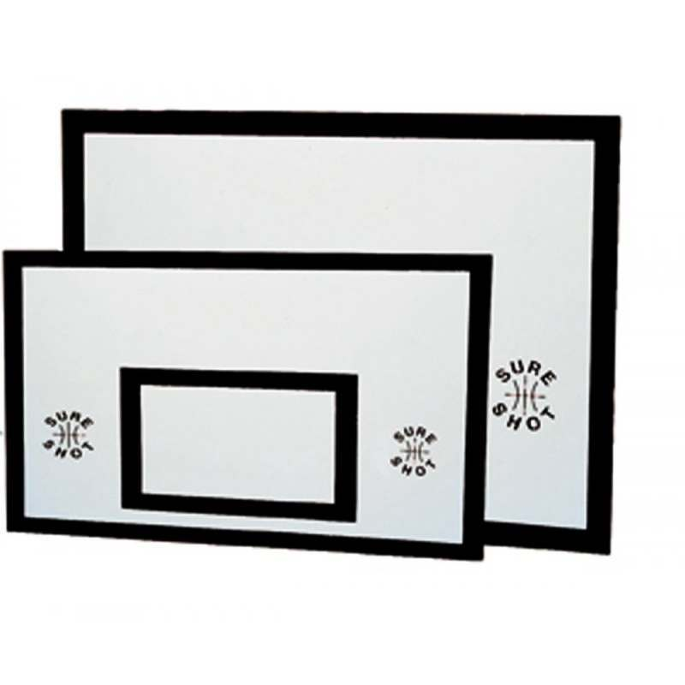
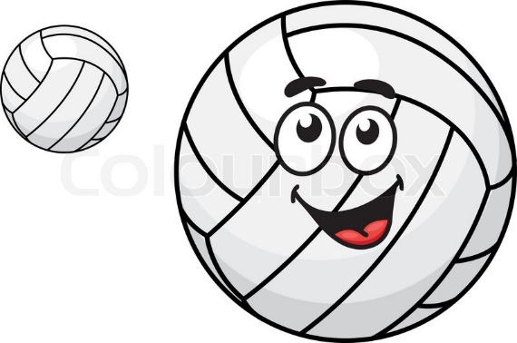
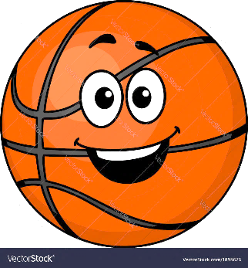
无 板 篮 球
No board basketball!
That is Netball!
+
=
wú bǎn lán qiú
wú bǎn lán qiú
无板篮球
No board
basketball
netball

Slide 10
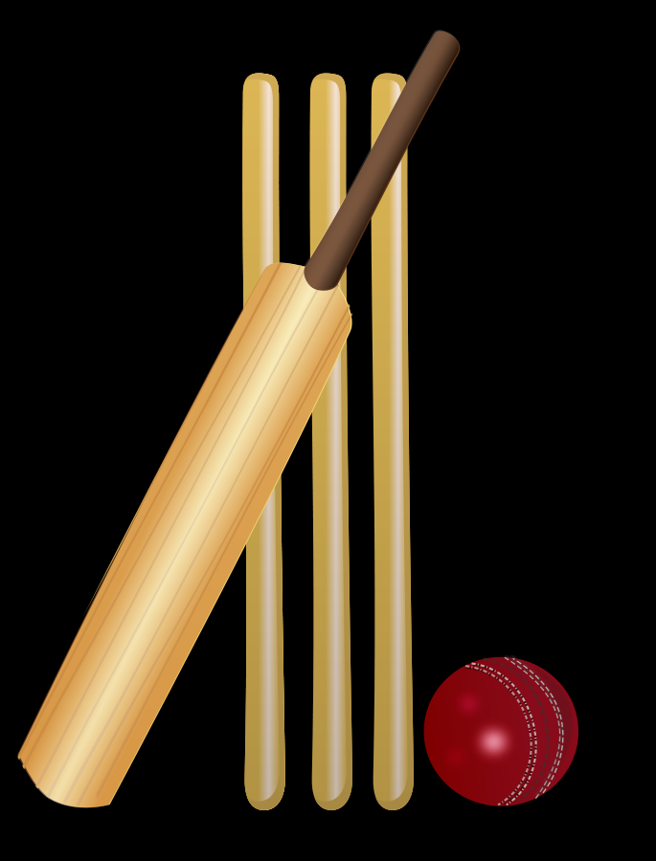
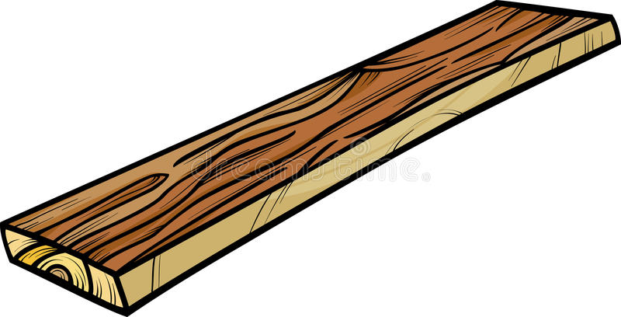
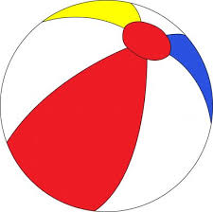
板 球
Board ball!
That is Cricket!
=
+
bǎn qiú
bǎn qiú
板球
board ball
cricket

Slide 11
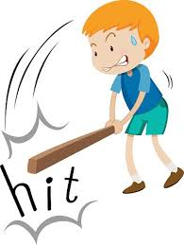
dǎ
打

Slide 12
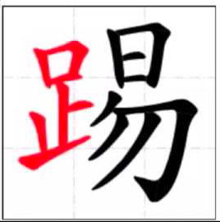
tī

Slide 13
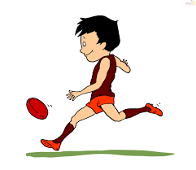
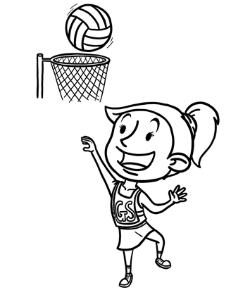
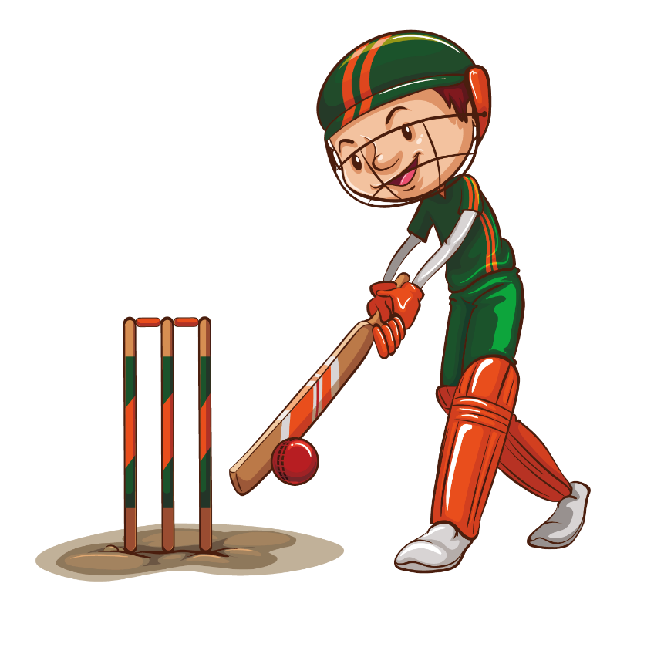
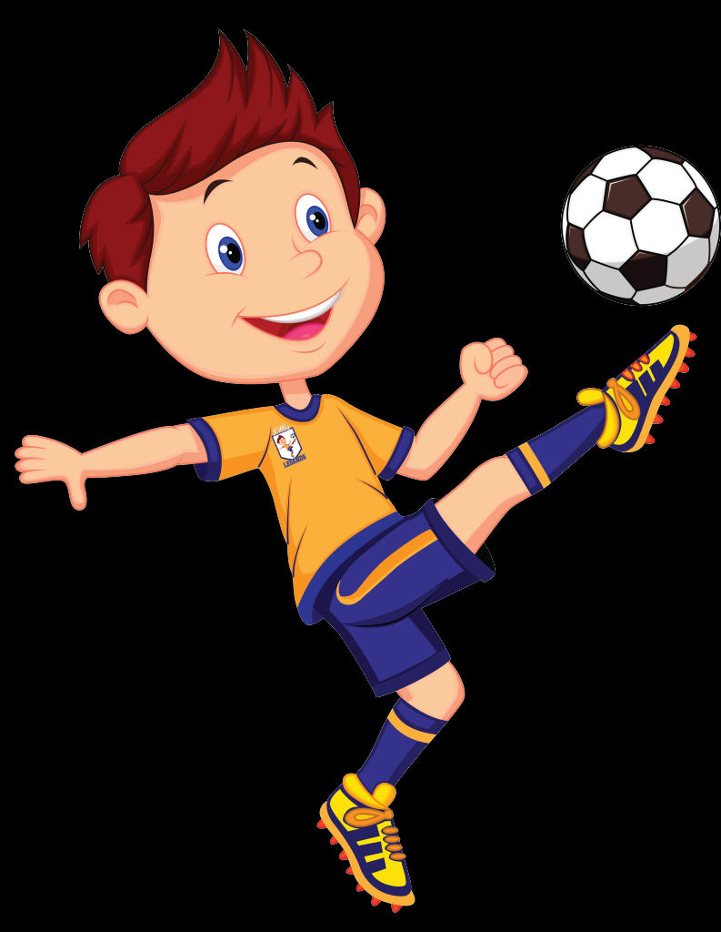
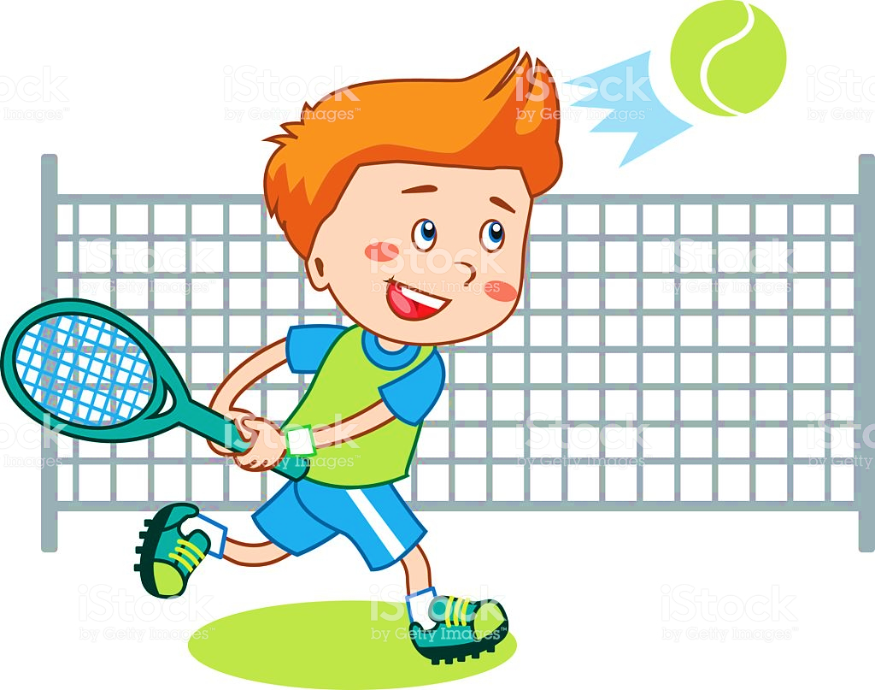
dǎ
打
tī

Slide 14
Groups competition – sentences
1
2
3
4
羽毛球
网球
+1 +1 +2 +1
+2 +3 +3 +1
+3 +1 +2 +2
score
score
score
score
5
6
7
8
乒乓球
篮球
踢
score
score
score
score
9
10
11
12
足球
score
score
score
score

Slide 15
Game: Making Sentences
Use the vocabulary cards to make the following sentences:
I like playing badminton.
He doesn’t like playing table tennis.
You like playing AFL.
I don’t like playing tennis.
She doesn’t like playing netball.
It likes playing soccer.
I don’t like playing cricket.
He likes playing basketball.

