Slide 1
Christmas Comparison

Slide 2
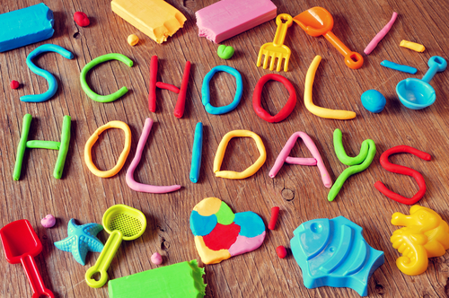
In Australia
Everybody in Australia enjoys the Christmas holiday – adults have a few days off work and students have many weeks of summer holiday.

Slide 3
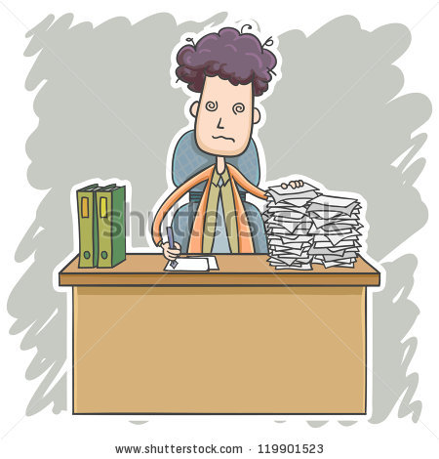
In China
Unlike Australians ,Chinese people need to work and study on Christmas.

Slide 4
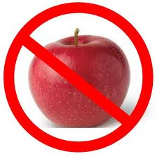
In Australia
We don’t have a tradition of eating apples during Christmas

Slide 5
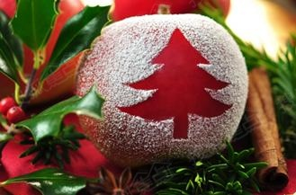
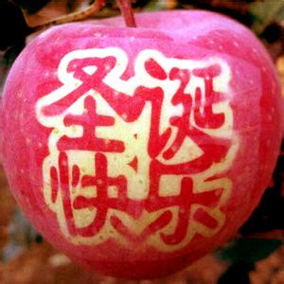
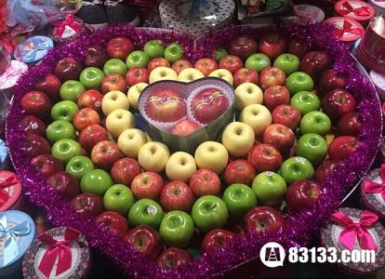
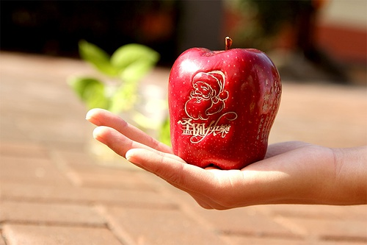
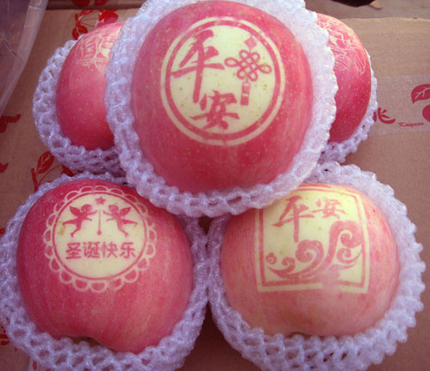
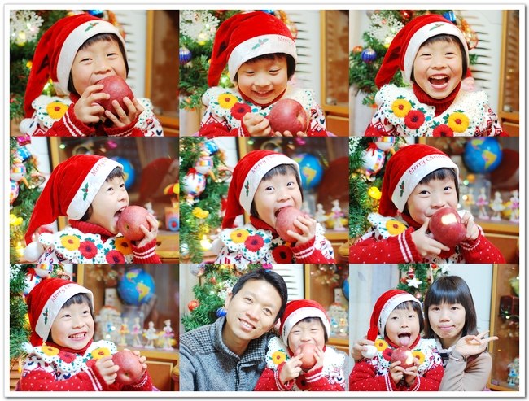
In China
Chinese people’s Christmas celebration starts on Christmas Eve. Many Chinese people eat apples on that day.

Slide 6
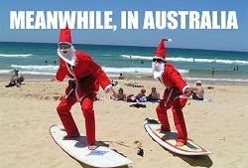
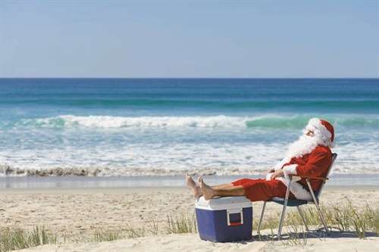
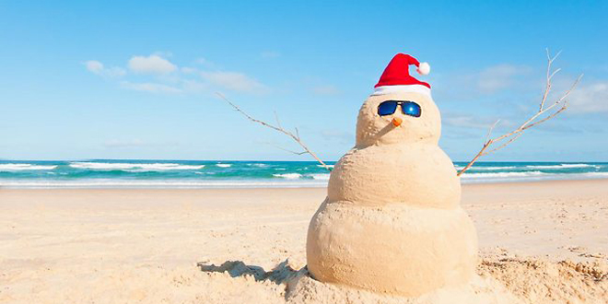
In Australia
Christmas is in December, it is summer!

Slide 7
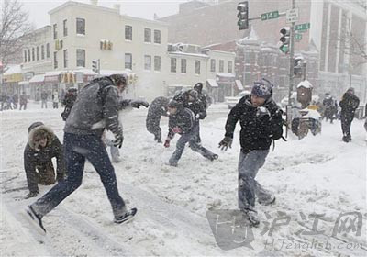
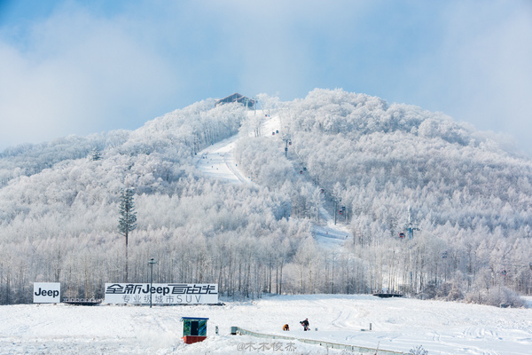
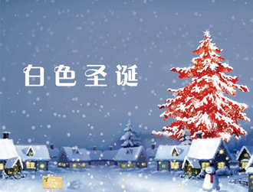
In China
It’s winter in China on Christmas Day. Sometimes, you can expect a white Christmas there.

Slide 8
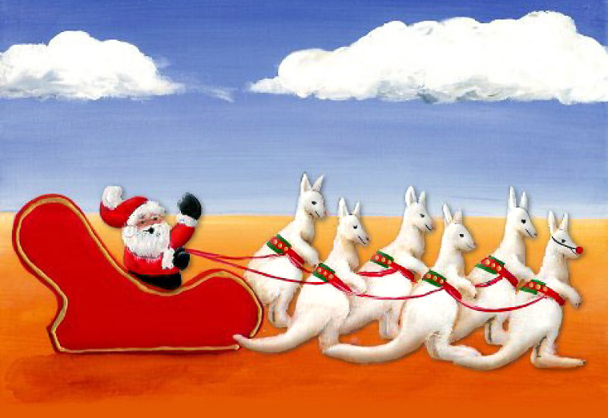
In Australia
Santa loves the beach and he comes to Australia on 6 white boomers

Slide 9
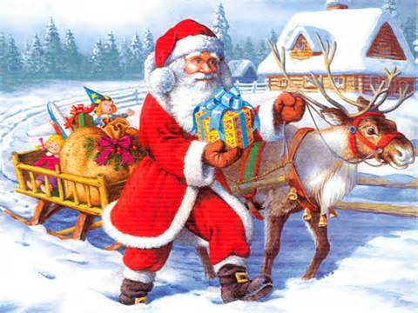
In China
Chinese people think that Santa Claus rides on his reindeer sleigh to send out gifts on Christmas eve.

Slide 10
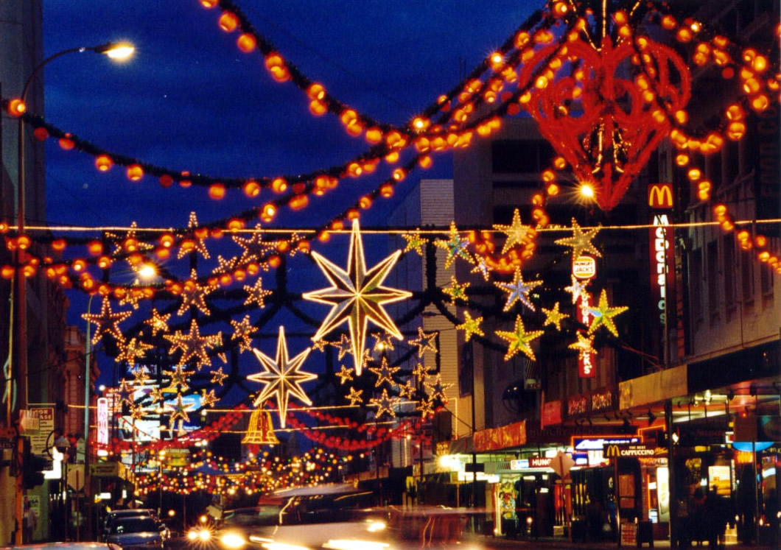
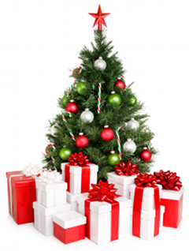
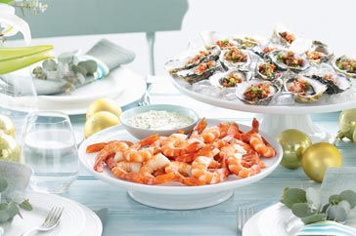
In Australia
Christmas is the busiest shopping time
Buy Christmas decoration
Buy gifts for family and friends
Prepare for Christmas lunch/dinner

Slide 11
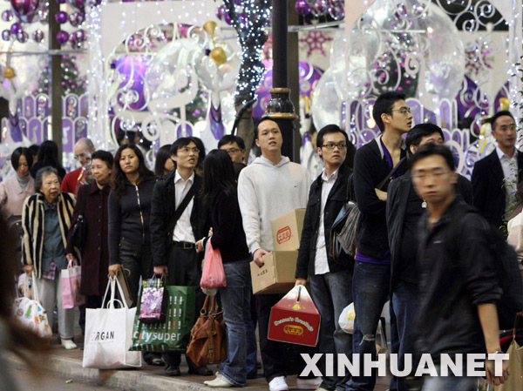
In China
Christmas sales start a few days before Christmas and it lasts for at least one week in China.
People like to rush into stores to buy a bargain.
Many stores in big cities will be open for 24 hours on Christmas Eve.

Slide 12
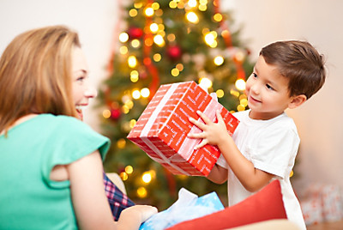
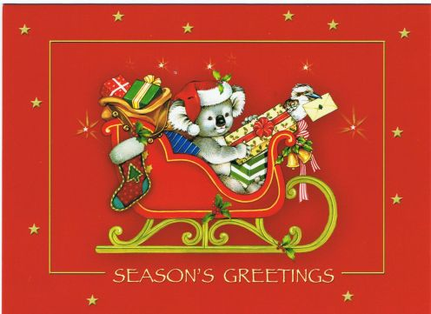
In Australia
We get a gift for our family and friends, especially a card!

Slide 13
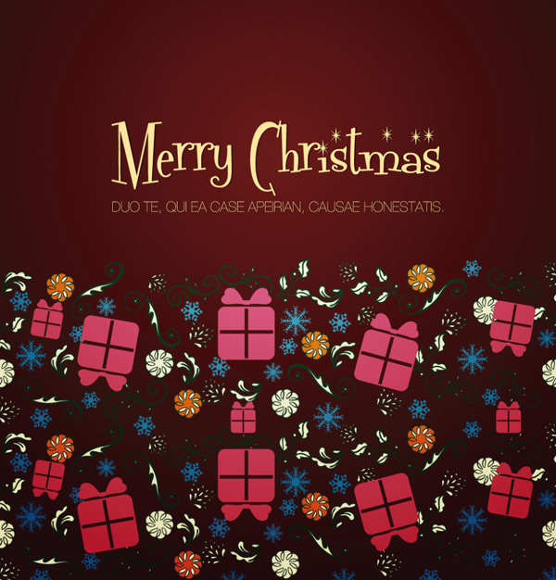
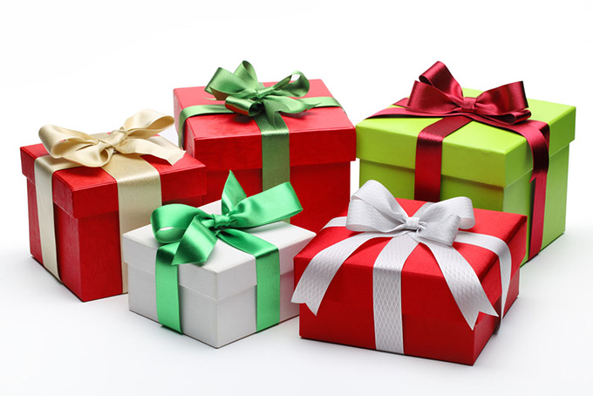
In China
Chinese people give all kind of gifts on Christmas, but they don’t like to write Christmas cards.

Slide 14
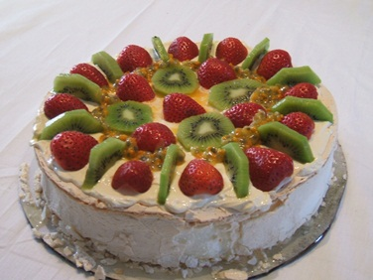
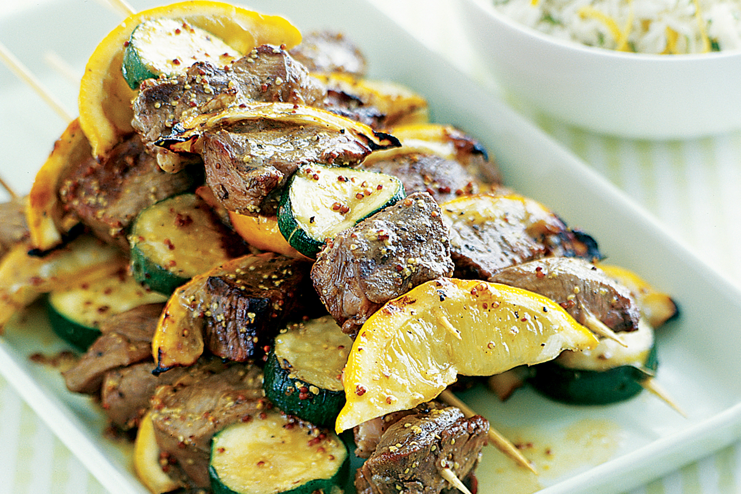
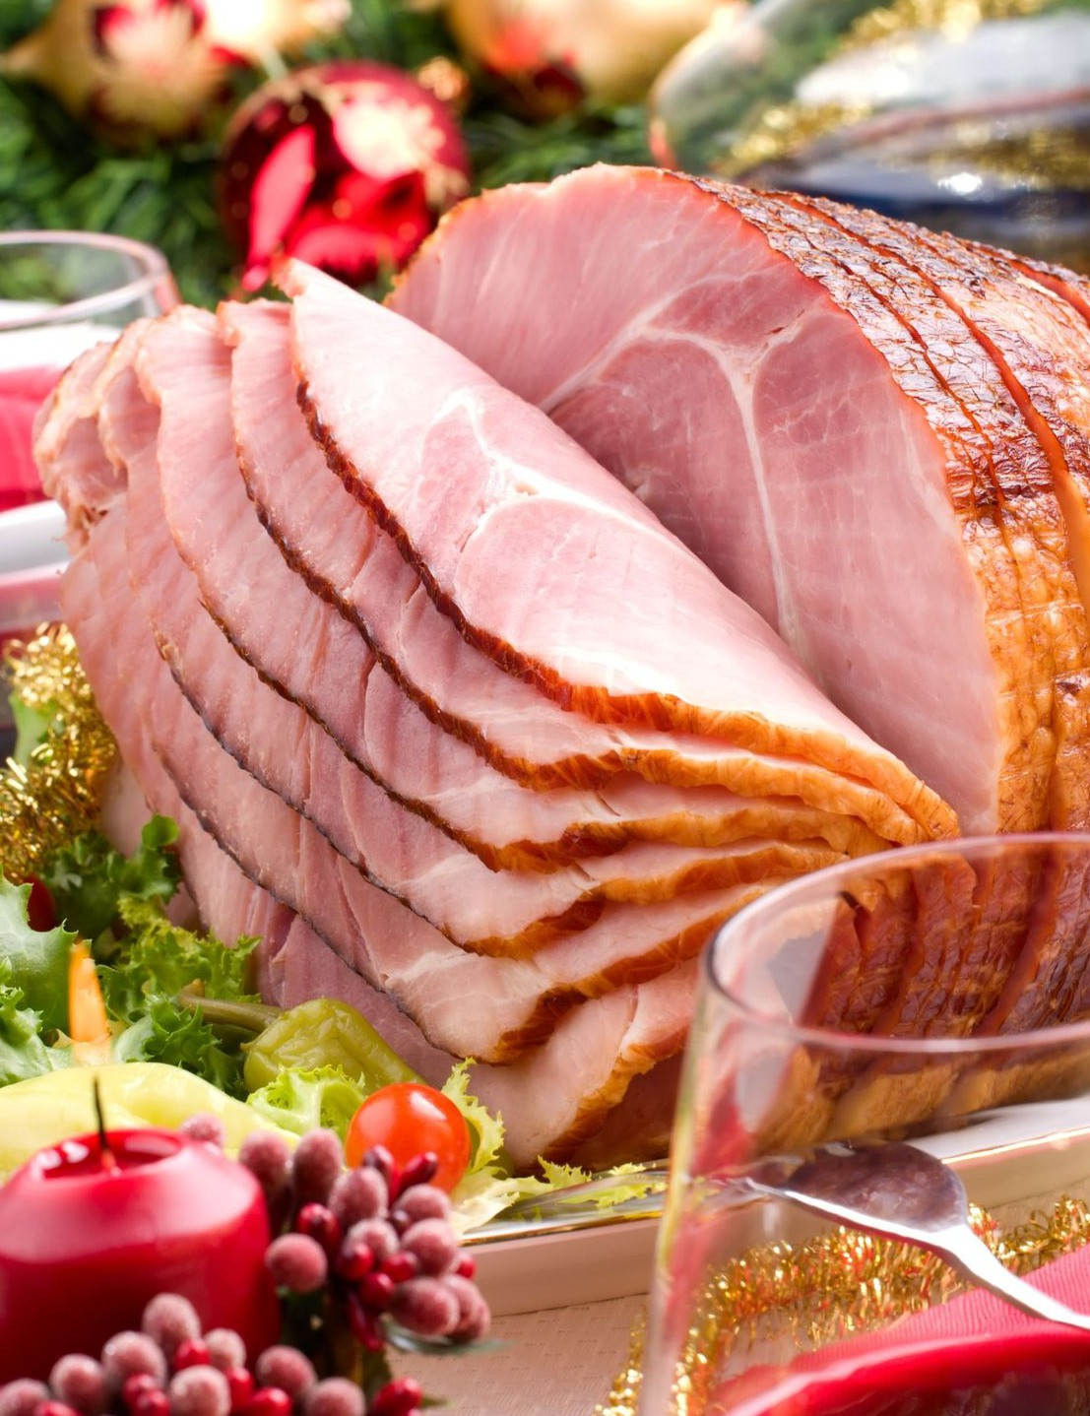
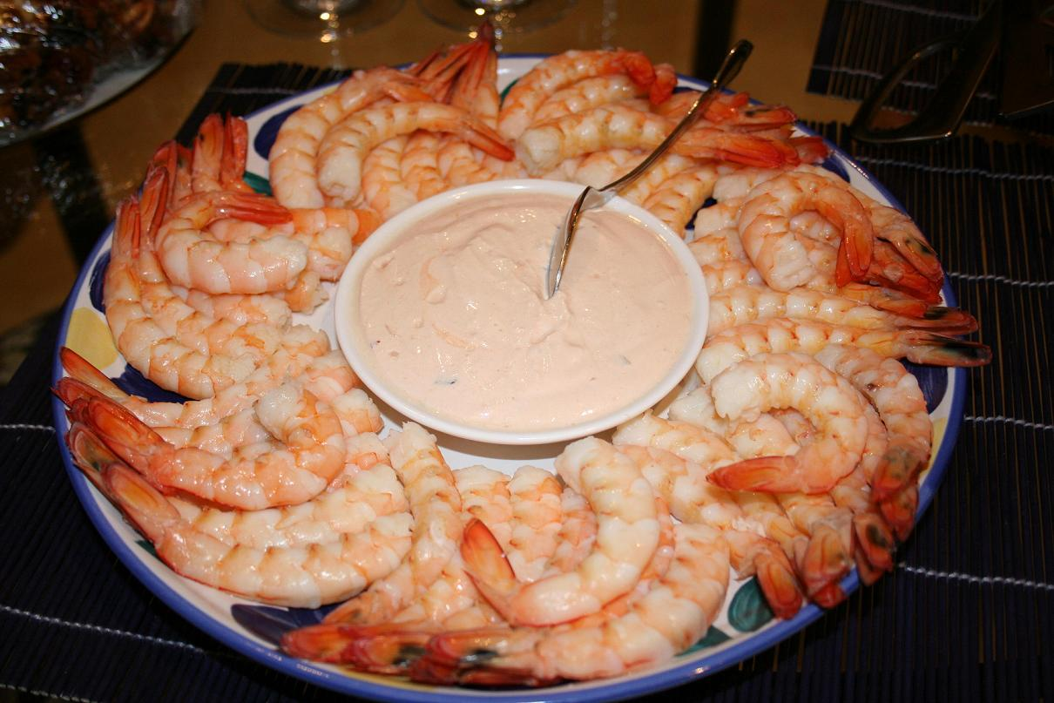
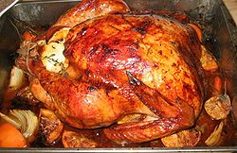
In Australia
During Christmas, people have lunch/dinner with family on Christmas day. The most popular food include:

Slide 15
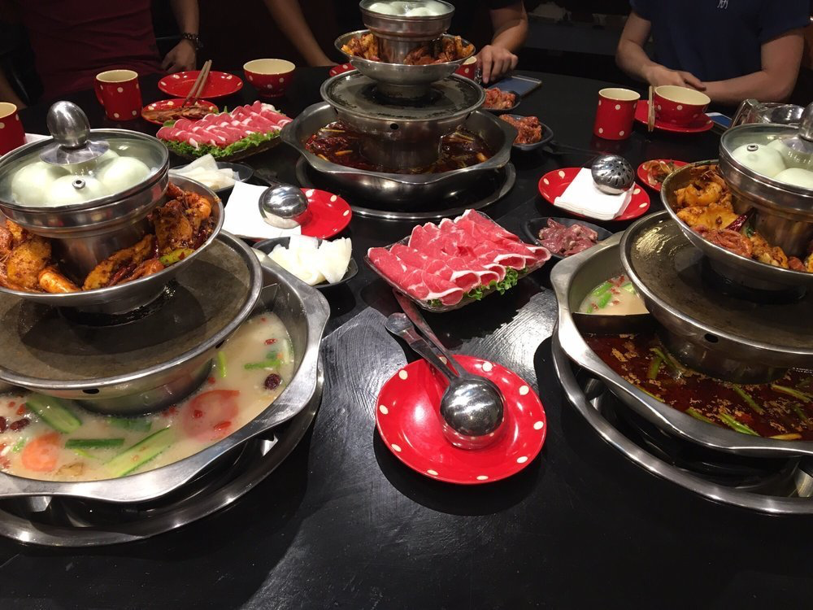
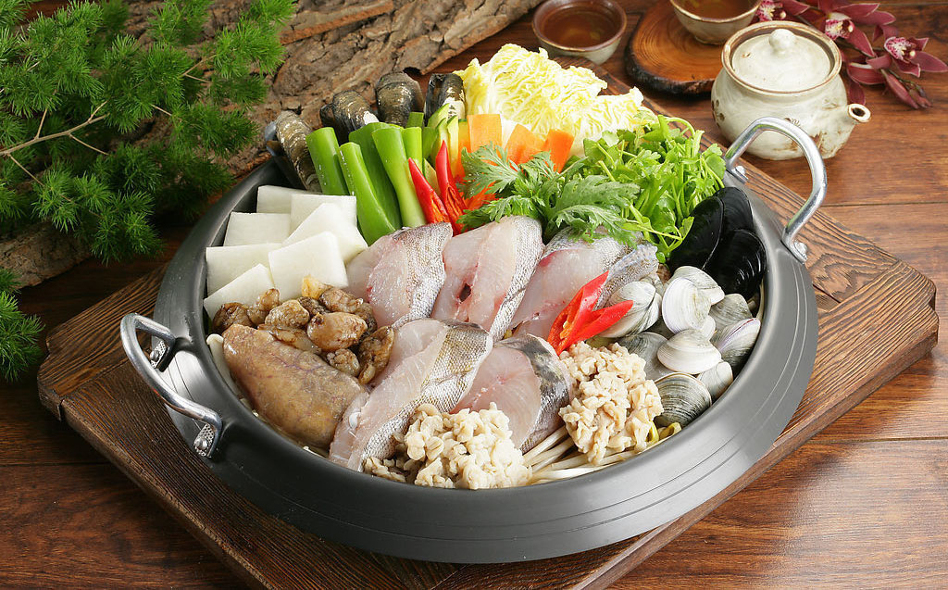
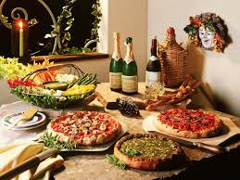
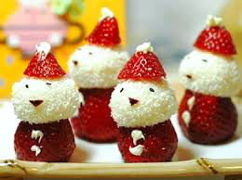
In China
Young people like to eat out on Christmas Eve

Slide 16
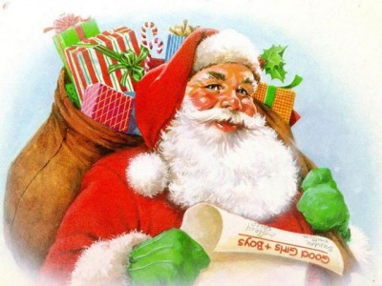
Christmas Greetings
Merry Christmas!!!
Shèngdàn kuàilè
圣 诞 快 乐
Christmas Happy

