Slide 1
Hàn zì 汉字
Chinese character

Slide 2
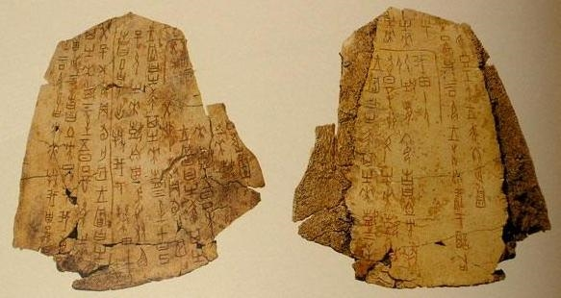
Chinese character is one of the world’s oldest writings. The earliest known scripts date back to more than3000 years. They were curved on turtle shells or bones.

Slide 3
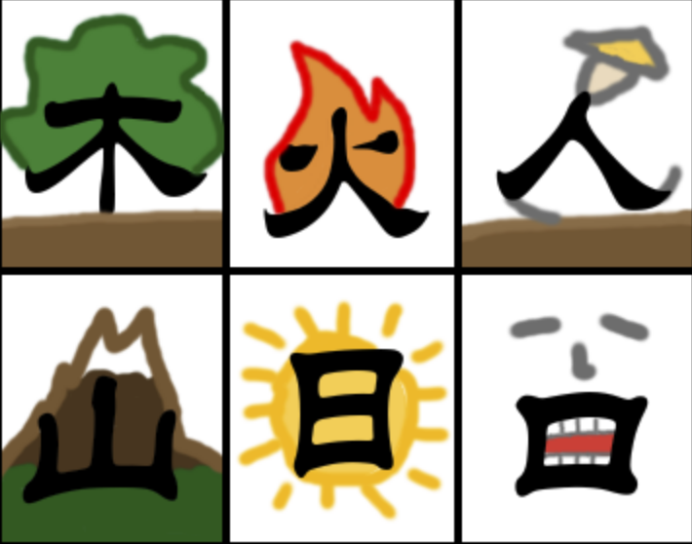
Some Chinese characters were created with their own image.

Slide 4
Chinese Character Structures
The structures of Chinese characters roughly can be divided into two different kinds, which are the single component (独体字) and the compound (合体字).
While the compound refers to those characters that have more than one component.

Slide 5
1. Single component
The single component refers to the characters that have only one complete and independent component.
Despite that there is a small amount of single component, most of them are widely used or act as a part of the compound character.
电(diàn electricity)
年 (nián year)
书 (shū book)
也 (yě also)

Slide 6
2. Compound Left-right structure
Compound refers to those characters that have more than one component.
你 nǐ
的 de
好 hǎo
姐 jiě

Slide 7
3. Compound- Top-bottom structure
Characters of left-right structure and top-bottom structure count for about 90% of all Chinese characters.
名 míng
字 zì
是 shì
英 yīng

Slide 8
4.1 Compound- Enclosed Structure
Enclosed on 3 sides.
a. Enclosed from top, left, bottom sides.
b. Enclosed from left, top, right sides.
c. Enclosed from left, bottom, right sides.
区qū
医yī
风fēng
同tóng
画huà

Slide 9
4.2 Compound- Enclosed Structure
(2) Enclosed on 4 sides.
国guó
囚qiú
回 huí

Slide 10
Basic structures of Chinese characters
日 月 山 水 羊 犬 人子
Single character
你 他 她 材 把 保 粘 朝
Left-right structure
它 旦 皇 肯 委 集 吉
Top-bottom structure
国 回 囚 圆 圈
Fully Enclosed structure

Slide 11
What structures are these characters?
糖 táng -sugar
送 sòng -give away
盐 yán -salt
几 jǐ -how many
纸 zhǐ -paper
笔 bǐ -pen
事 shì -matter
选 xuǎn -choose

Slide 12
Please clarify the following characters. Write down its number under each catalogue.
1.日 2.他 3.息 4.泰 5.中 6.山 7.学 8.利 9.水 10.你 11.澳 12.她 13.它 14.我 15. 宁 16.回 17.四 18.国
Single characters:_____________
Left-right structure:___________________
Top-bottom structure:__________
Fully enclosed structure:__________

Slide 13
Let’s check your answers
Single characters: 1、5、6、9、14、17
Left-right structure: 2、8、10、11、12
Top-bottom structure: 3、4、7、13、15
Fully enclosed structure: 16、18

Slide 14
Group characters based on meaning
Pronouns:你我他她它
Family members: 爸妈哥弟姐妹
Chinese numbers: 一二三四五六七八九十
Country：国、中(Abbr: 中国)、澳(Abbr: 澳大利亚)
Measure word:个
Others：岁囚龙和两年上叫

Slide 15
Group characters based on structure
Single :一二三四五六七八九十
个龙和两年上中哥弟我
Left-right:澳你他她妈姐妹叫
Top-bottom:岁爸它
Fully enclosed:国囚

