Slide 1
Family Members

Slide 2
My Family Members
wǒ de
我的
My
jiā rén
家人
Family members

Slide 3
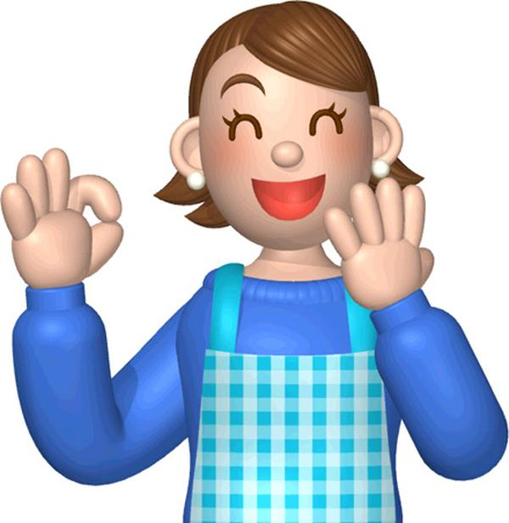
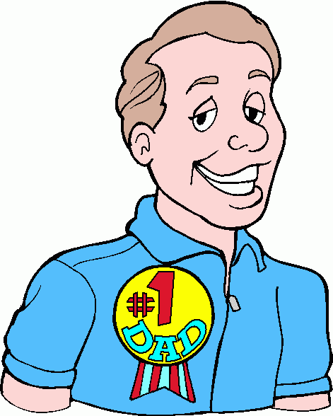
Dad and mum
bà ba
爸爸
Dad
mā ma
妈妈
Mum

Slide 4
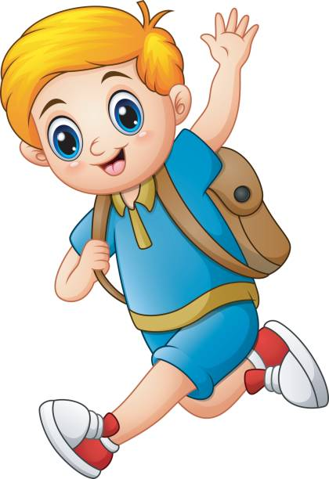
Elder brother and younger brother
gē ge
哥哥
Elder brother
dì di
弟弟
Younger brother

Slide 5
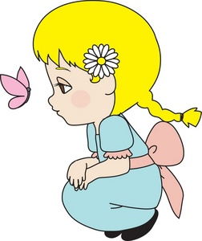
Elder sister and younger sister
jiě jie
姐姐
Elder sister
mèi mei 妹妹
Younger sister

Slide 6
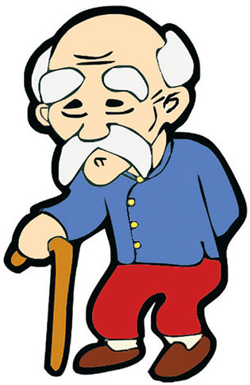
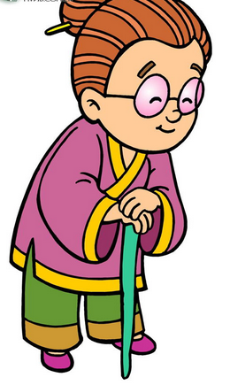
Grandpa and grandma
yé ye
爷爷
Grandpa
nǎi nai 奶奶
Grandma

Slide 8
I/me
wǒ
我
I / me

Slide 9
Love
ài
爱
Love

Slide 10
I love dad.
Wǒ ài wǒ de bà ba.
我爱我的爸爸.

Slide 11
I love mum.
Wǒ ài wǒ de mā ma.
我爱我的妈妈.

Slide 12
我爱（wǒ ài）我的（ wǒ de ）

