Slide 1
第 7 课
《HSK标准教程》第2册
你家离公司远吗

Slide 2
kǎoshì
考 试 exam
bǐshì
笔试 writing test
cānjiā kǎoshì
参加 考试 attend a test
kǒushì
口试 speaking test
zhōngkǎo
中考 high school entrance exam
gāokǎo
高考 college entrance exam

Slide 3
shāngdiàn
商店 store/shop
shāngchǎng
商场 shopping mall
chāoshì
超市 supermarket

Slide 4
jīchǎng
机场 airport
hòujītīng
候机厅 waiting hall
fēijī
飞机 airplane
zhíjī
值机 check in
dēngjī
登机 boarding
dēngjīpái
登机牌 boarding pass

Slide 5
dàolù道路 road
mǎlù马路 road
lùshàng路上 on the way
zài lái/qù … de lùshàng
在 来/去……的 路上 on the way to …
jiàoshì
教室 classroom
xuéxiào
学校 school
gōngsī
公司 company
bàngōngshì
办公室 office

Slide 6
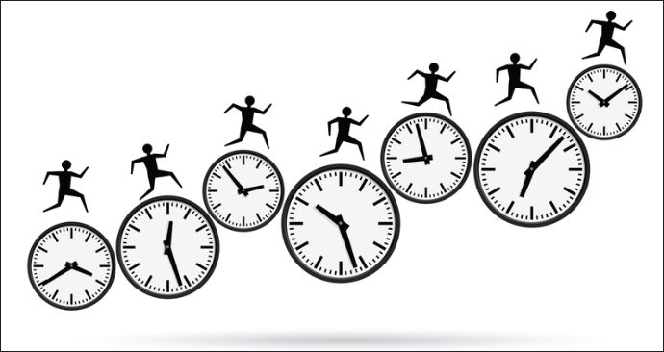
shíjiān
时间 time
chīfàn/xuéxí/xiūxī shíjiān
吃饭/学习/休息 时间 meal/study/rest time
…xūyào duōcháng shíjiān
…需要多长时间 how much time will it take
…de shíhòu
……的 时候 when (at a time)

Slide 7
zuò
坐 take (a public transportation)
zìxíngchē/
dānchē
自行车/单车
gōnggòng qìchē
公共汽车
qí
骑 ride
chūzūchē/
dishì
出租车/的士
fēijī
飞机

Slide 8
Wǒ zuò/qí … qù …
我 坐/骑…… 去……

Slide 9
Continuation with “还hái"
Although 还(hái) has many meanings, the basic meaning of "still" to indicate a continuing action is essential to the word.
Often 在(zài) will appear with 还(hái), as it is natural to talk about continuous actions that are still happening.

Slide 10
Sub. + 还在(hái zài) + [Verb Phrase]
Yǐjīng zhōngwǔ le, tā hái zài shuìjiào.
已经 中午 了 ，他 还 在 睡觉。
It's already noon and he's still sleeping.
Shídiǎn le, tā hái zài xuéxí.
十点了，他还在学习。
It’s ten o’clock and he is still learning.

Slide 11
Sub. + 还在(hái zài) + [Verb Phrase]
Tā hái zài jiàoshì xuéxí.
他还在教室学习。
He is still studying in the classroom.
Tā hái zài shēngqì.
她 还 在 生气。
She is still angry.

Slide 12
Negative Form: Sub. + 还hái + 不bù / 没méi + [Verb Phrase]
When you put 不(bù) or 没(méi) after 还(hái) in a question sentence, it can be used to emphasize the idea of what should be happening in a more idiomatic way.

Slide 13
Sub. + 还(hái) + 不(bù) / 没(méi) + [Verb Phrase]
Nǐ zěnme hái méi chīfàn?
你怎么还没吃饭？
Why haven’t you eaten yet?
Wǒmen děng le bàn gè xiǎoshí le. Lǎoshī hái méi dào.
我们 等 了 半 个 小时 了 ，老师 还 没 到。
We've been waiting for half an hour, but the teacher still hasn't arrived.

Slide 15
Yǐjīng zhōngwǔ le, tā hái zài shuìjiào.
已经 中午 了 ，他 还 在 睡觉。
It's already noon and he's still sleeping.
Shídiǎn le, tā hái zài xuéxí.
十点了，他还在学习。
It’s ten o’clock and he is still learning.
Tā hái zài jiàoshì xuéxí.
他还在教室学习。
He is still studying in the classroom.

Slide 17
Expressing earliness with “就jiù"
Just as 才(cái) can express lateness, 就 (jiù) can be used to indicate that something happened earlier or sooner than expected.
It can also be used in the near future to indicate something will happen very soon.

Slide 18
Structure: Subj. + Time + 就 (jiù) + Verb
Used as "Right Away" (in the Future).
When something happens "right away," you're talking about "very soon" in the future.
Note that it can sometimes be hard to translate the feeling of "soonness" into English, but in every one of these examples, the time given in the sentences feels "soon" to the speaker.

Slide 19
Subj. + Time + 就 (jiù) + Verb
Wǒ mǎshàng jiù lái.
我 马上 就 来 。
I'll be there in a second.
Tāmen yīhuìr jiù dào.
他们 一会儿 就 到 。
They will be here in a few minutes.
Lǎobǎn míngtiān jiù huílái.
老板 明天 就 回来 。
The boss will be back tomorrow.

Slide 20
Structure: Subj. + Time +就 (jiù) + Verb + 了le
Used as "Early" (in the Past)
This use of 就 (jiù) might be translated "as early as," but usually the earliness is not specifically marked in English.

Slide 21
Subj. + Time +就 (jiù) + Verb + 了le
Wǒmen jiǔ diǎn shàngkè, tā bā diǎn jiù lái le.
我们 九点 上课 ，他 八点 就 来 了 。
We have class at nine, but he came in at eight.
Fēijī shí diǎn qǐfēi, tā liù diǎn jiù dào jīchǎng le.
飞机 十点 起飞 ，他 六点 就 到 机场 了 。
The plane takes off at ten o'clock, but he arrived at the airport at six.

Slide 22
Subj. + Time +就 (jiù) + Verb + 了le
Wǒ zuówǎn bā diǎn bàn jiù shuìjiào le.
我 昨晚 八 点 半 就 睡觉 了 。
I went to bed at eight thirty last night.
Tā shíbā suì jiù jiéhūn le.
她18岁就结婚了。
She got married at 18 years old.

Slide 24
Chinese Radicals:“彳”“攵”

Slide 25
Expressing distance with "离 (lí) "
Unless you're talking about a very specific distance, you'll normally want to pair 离 (lí) with the adjective 近 (jìn) for "close," or 远 (yuǎn) for "far."

Slide 26
Place 1 +离 (lí) + Place 2 + Adv. + 近 / 远
Wǒ jiā lí gōngsī hěn jìn.
我 家 离 公司 很 近。
My house is close to my office.
Měiguó lí Zhōngguó hěn yuǎn.
美国 离 中国 很 远。
The USA is far from China.
Zhège jiǔdiàn lí jīchǎng hěn jìn.
这 个 酒店 离 机场 很 近。
This hotel is very close to the airport.
jìn: near/close to
yuǎn: far away
hěn:very

