Slide 1
第 6 课
《HSK标准教程》第2册
你怎么不吃了

Slide 2
喝牛奶
hē niúnǎi drink milk
起床
qǐchuáng get up
跑步
pǎobù running
看报纸
kàn bàozhǐ read newspaper
吃药
chīyào take medicine
打篮球
dǎ lánqiú play basketball

Slide 3
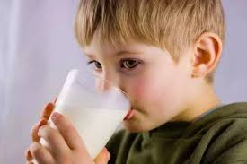
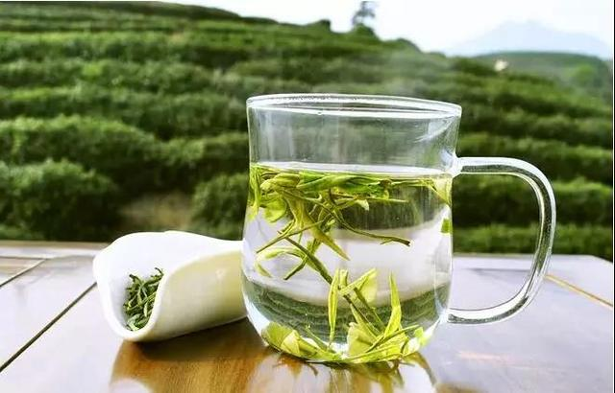
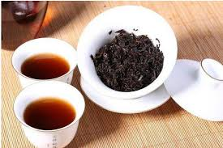
hē niúnǎi
喝 牛奶
hē kāfēi
喝 咖 啡
hē lǜchá
喝 绿 茶
hē hóngchá
喝 红 茶
xiǎngyào
想 要 want to
xǐhuān/bù xǐhuān
喜 欢/ 不喜欢 like/dislike

Slide 4
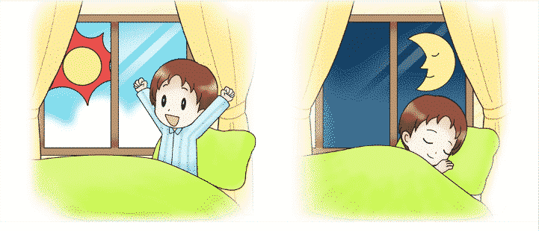
qǐchuáng
起 床
shuìjiào
睡 觉
měitiān
每 天 everyday
chángcháng
常常 usually

Slide 5
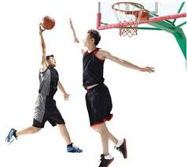
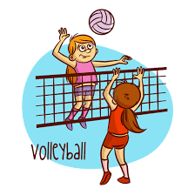
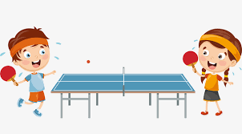
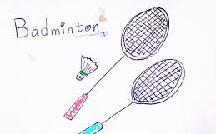
dǎqiú
打球
dǎ lán qiú
打篮球
dǎ pái qiú
打排球
dǎ pīng pāng qiú
打乒乓球
dǎ yǔ máo qiú
打羽毛球
dǎ gāo ěr fū qiú
打高尔夫球

Slide 6
kànbàozhǐ
看报纸
rìbào
日报
zhōubào
周报

Slide 7
shēngbìng
生病
kànyīshēng
看医生
ànshí chīyào
按时 吃药

Slide 8
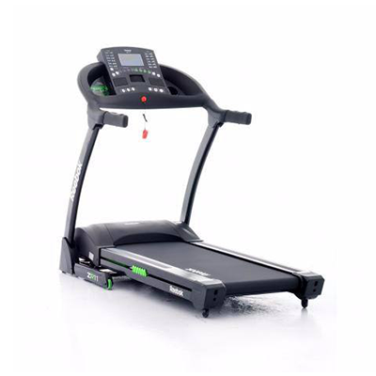
pǎobù
跑步
sànbù
散步
pǎobùjī
跑步机
mànpǎo
慢跑

Slide 9
Asking why with "怎么 (zěnme) "
Aside from just meaning “how”怎么 (zěnme) can also be used to ask "why" or "how come.”

Slide 10
Basic Usage
Structure Subj. + 怎么 + Verb + Obj. ?
Similar to the question word 为什么 (wèishénme), questions can also be asked with 怎么 (zěnme).
This has similar connotations to saying "how come" in English. It not only asks why, but expresses some surprise at the situation, and in some cases even disagreement with it.

Slide 11
Examples
Tā bāng le nǐ, nǐ zěnme bù shuō "xièxie"?
他 帮 了 你，你 怎么 不 说 “谢谢” ？
He helped you. How come you didn't say thank you?
Nǐ jiéhūn de shíhou zěnme bù gàosu wǒ?
你 结婚 的时候 怎么 不 告诉 我？
How come you didn't tell me when you got married?
Jīntiān shì Xīngqīyī, nǐ zěnme bù qù shàngbān?
今天 是 星期一，你 怎么 不 去 上班？
Today is Monday. Why aren't you going to work?

Slide 12
“Why So...” Usage Structure Subj. + zěnme + zhème / nàme + Adj. This use of 怎么 (zěnme) could be translated as either "how" or "why"; the actual meaning falls in the fuzzy region between the two. In any case, it's used to express disbelief: how can (something) be so (adjective)?!

Slide 13
Examples
Tā zěnme nàme lǎn?
他 怎么 那么 懒？
How can he be so lazy?
Zuótiān zěnme nàme lěng?
昨天 怎么 那么 冷？
How could it be so cold yesterday?
Nǐ de Hànyǔ zěnme zhème hǎo?
你的 汉语 怎么 这么 好？
How is your Mandarin so good?

Slide 14
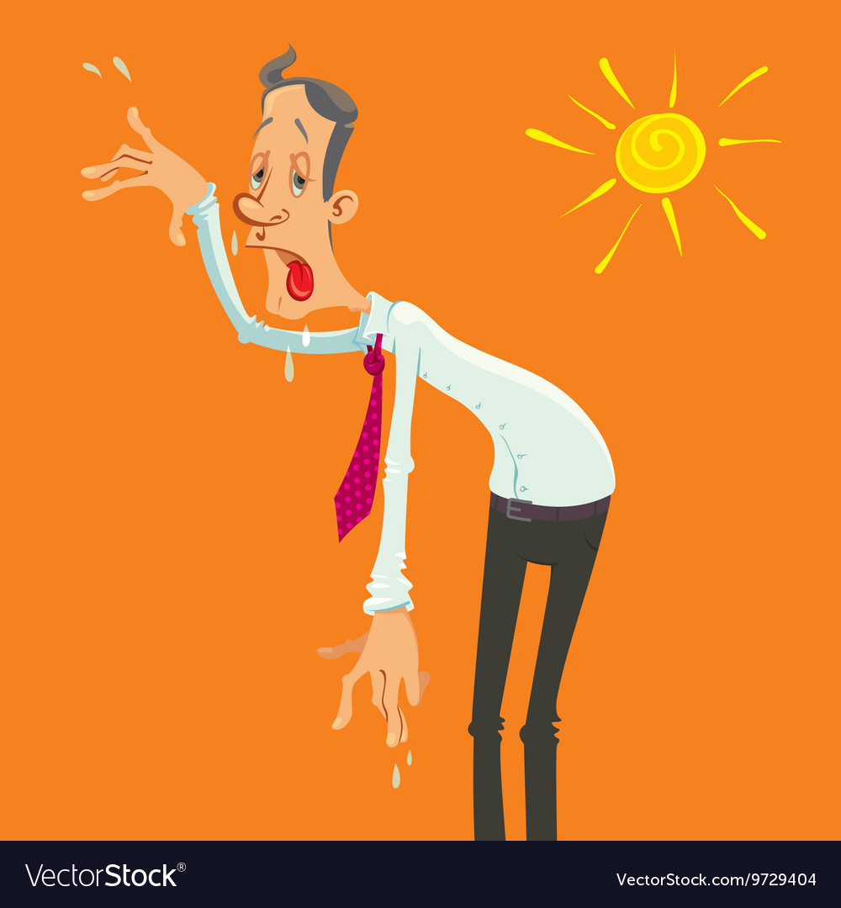
Ask and answer questions using ‘zenme’

Slide 15
Reduplication of measure words
If you know what a measure word is and how to use it, you may be ready for this pattern, where the measure word can repeat, or "reduplicate." It's not a terribly common structure, but the two most common examples of it are 个个(gègè) and 天天(tiāntiān). It adds the meaning of "every" to the noun that follows.

Slide 16
Structure Subj + MW + MW + Predicate The reduplicated measure word should precede the predicate of the sentence, often a verb phrase or an adjective. By far, the most commonly reduplicated measure words are 个个(gègè) (meaning "every one" of something) and 天天(tiāntiān) (meaning "every day"). For less common measure words, the meaning is still the same: "every" of something (for which the measure word applies).

Slide 17
Examples
Tóng xué men gè gè dōu hěn qín fèn 。
同学们个个都很勤奋。
The students are all very diligent.
Zhè gè shāng diàn de yī fú jiàn jiàn dōu hěn piāo liàng 。
这个商店的衣服件件都很漂亮。
All the clothes in this shop are beautiful.
Zhè gè xīng qī wǒ tiān tiān dōu chī yáng ròu 。
这个星期我天天都吃羊肉。
I've eaten mutton every day this week.

Slide 18
Examples
Xiànzài jiā jiā dōu yǒu shǒujī.
现在家家都有手机 。
Everyone has a cell phone now.
Zhèxiē xiǎogǒu zhī zhī dōu hěn kěài.
这些小狗只只都很可爱。
All these puppies are cute.
Tóngxuémen niánnián dōu zài jìnbù 。
同学们年年都在进步。
The students are improving year after year.

Slide 19
Describe the pictures using the newly-learned language points and words.

Slide 20
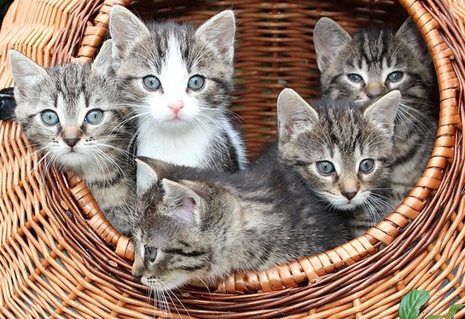
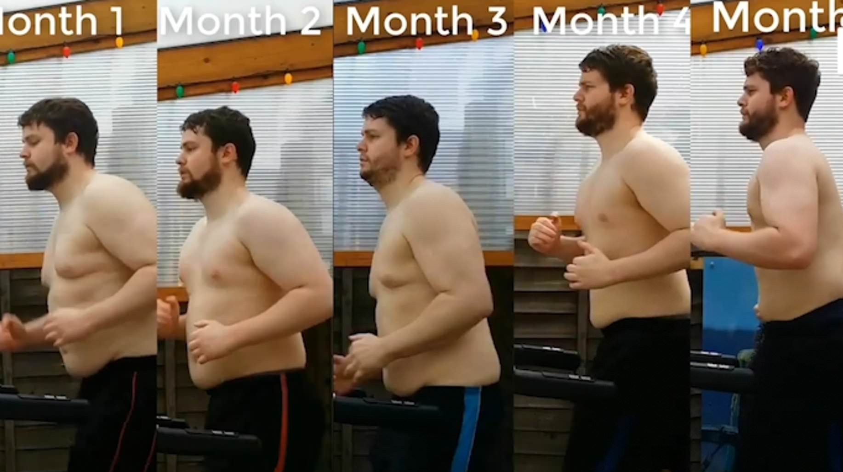
Use the Reduplication of measure words to make up sentences.

Slide 21
Cause and effect with " yīnwèi " and " suǒyǐ "
You will often come across 因为⋯⋯所以⋯⋯ (yīnwèi... suǒyǐ...) in both written and spoken Chinese. This pattern will give your Chinese a clear logical structure, and can help make you more persuasive.
A common way to explain causes in Chinese is with 因为 (yīnwèi). This is equivalent to "because" in English. Usually 因为 (yīnwèi) will begin a new phrase in a sentence.

Slide 22
Structure
In this structure, we first state the result, and then give the reason in the next statement after the 因为 (yīnwèi).
Result, 因为(yīnwèi) + Reason

Slide 23
Examples
Tā xué de hěn kuài, yīnwèi tā hěn cōngming.
他学得很快,因为他很聪明 。
He learns fast because he is smart.
Wǒ ài chī Sìchuān cài, yīnwèi hěn là.
我爱吃四川菜，因为很辣 。
I love eating Sichuan food because it's very spicy.
Wǒ zài xuéxí Zhōngwén, yīnwèi wǒ xiǎng qù Zhōngguó.
我在学习中文，因为我想去中国 。
I am studying Chinese because I want to go to China.

Slide 24
Using 所以 (suǒyǐ) by Itself to Explain Results
Just as 因为 (yīnwèi) can be used to explain causes, 所以 (suǒyǐ) can be used to explain results. This is the equivalent of "so…" or "therefore…" in English.
This pattern is similar to the expression using both 因为 (yīnwèi) and 所以 (suǒyǐ), but it leaves out the beginning 因为 (yīnwèi). This structure is more informal.

Slide 25
Structure: Reason, 所以 + Result
Tā hěn piàoliang, suǒyǐ hěn duō nánhái xǐhuan tā.
她 很 漂亮，所以 很 多 男孩 喜欢 她。
She is very beautiful, so a lot of boys like her.
Tā zhǎodào gōngzuò le, suǒyǐ hěn gāoxìng.
他 找到 工作 了， 所以 很 高兴。
He found a job so he's happy.
Wǒ tài máng le, suǒyǐ méiyǒu shíjiān gěi nǐ dǎ diànhuà.
我 太 忙 了，所以 没有 时间 给 你 打 电话。
I was too busy, so I didn't have time to give you a call.

