Slide 1
第 6 课
《HSK标准教程》第2册
你怎么不吃了

Slide 2
Structure：Subj. + 怎么 + Verb + Obj. ?
Tā bāng le nǐ, nǐ zěnme bù shuō "xièxie"?
他 帮 了 你，你 怎么 不 说 “谢谢” ？
He helped you. How come you didn't say thank you?
Nǐ jiéhūn de shíhou zěnme bù gàosu wǒ?
你 结婚 的时候 怎么 不 告诉 我？
How come you didn't tell me when you got married?
Jīntiān shì Xīngqīyī, nǐ zěnme bù qù shàngbān?
今天 是 星期一，你 怎么 不 去 上班？
Today is Monday. Why aren't you going to work?

Slide 3
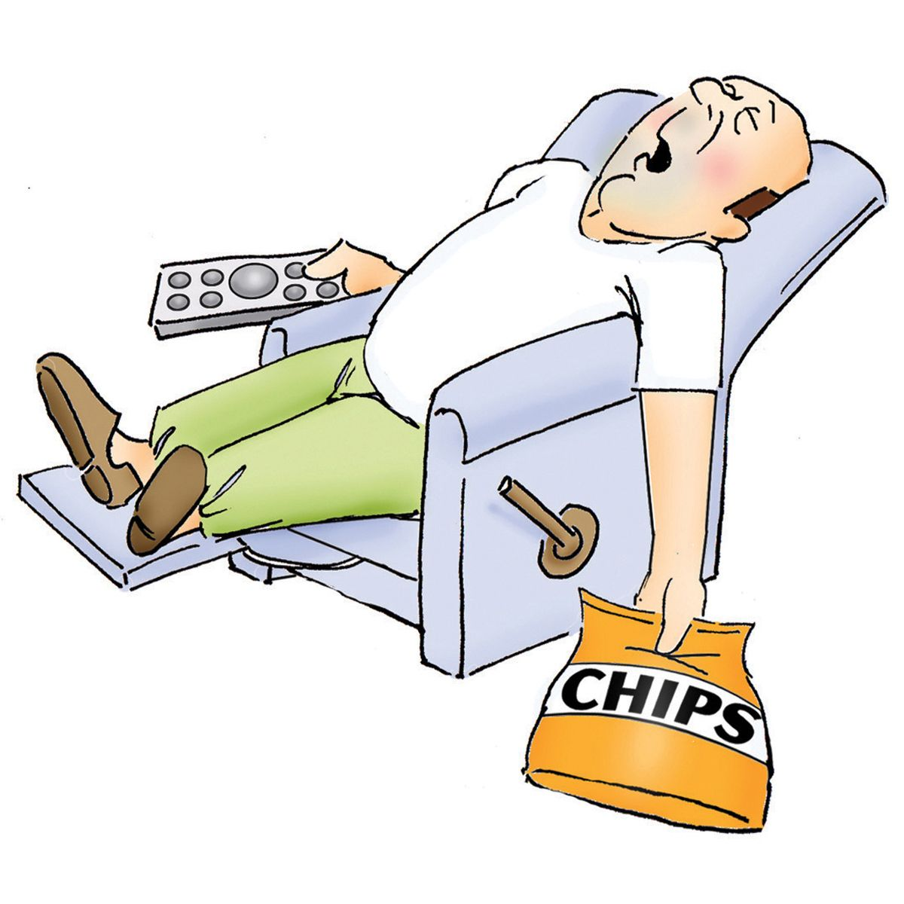
“Why So...” Usage Subj. + zěnme + zhème / nàme + Adj.
Tā zěnme nàme lǎn?
他 怎么 那么 懒？
How can he be so lazy?
Zuótiān zěnme nàme lěng?
昨天 怎么 那么 冷？
How could it be so cold yesterday?
Nǐ de Hànyǔ zěnme zhème hǎo?
你的 汉语 怎么 这么 好？
How is your Mandarin so good?

Slide 4
Reduplication of measure words
Tóng xué men gè gè dōu hěn qín fèn 。
同学们个个都很勤奋。
The students are all very diligent.
Zhè gè shāng diàn de yī fú jiàn jiàn dōu hěn piāo liàng 。
这个商店的衣服件件都很漂亮。
All the clothes in this shop are beautiful.
Zhè gè xīng qī wǒ tiān tiān dōu chī yáng ròu 。
这个星期我天天都吃羊肉。
I've eaten mutton every day this week.

Slide 5
Cause and effect with " yīnwèi " and " suǒyǐ ”
Result, 因为(yīnwèi) + Reason
Tā xué de hěn kuài, yīnwèi tā hěn cōngming.
他学得很快,因为他很聪明 。
He learns fast because he is smart.
Wǒ ài chī Sìchuān cài, yīnwèi hěn là.
我爱吃四川菜，因为很辣 。
I love eating Sichuan food because it's very spicy.
Wǒ zài xuéxí Zhōngwén, yīnwèi wǒ xiǎng qù Zhōngguó.
我在学习中文，因为我想去中国 。
I am studying Chinese because I want to go to China.

Slide 6
Using 所以 (suǒyǐ) by Itself to Explain Results Structure: Reason, 所以 + Result
Tā hěn piàoliang, suǒyǐ hěn duō nánhái xǐhuan tā.
她 很 漂亮，所以 很 多 男孩 喜欢 她。
She is very beautiful, so a lot of boys like her.
Tā zhǎodào gōngzuò le, suǒyǐ hěn gāoxìng.
他 找到 工作 了， 所以 很 高兴。
He found a job so he's happy.
Wǒ tài máng le, suǒyǐ méiyǒu shíjiān gěi nǐ dǎ diànhuà.
我 太 忙 了，所以 没有 时间 给 你 打 电话。
I was too busy, so I didn't have time to give you a call.

Slide 7
Using 因为 (yīnwèi) and 所以 (suǒyǐ) Together
The full pattern 因为……所以…… (yīnwèi... suǒyǐ...) is used to clearly indicate cause and effect. They could be thought of as equating to: "Since ___ happened, so ___ happened." It sounds weird to use both "since" and "so" in one sentence in English, but it makes everything crystal clear in Chinese.
Structure
因为(yīnwèi) + Cause, 所以(suǒyǐ) + Effect
This expresses that because of cause, therefore there is a result.

Slide 8
Examples
Yīnwèi wǒ yǒu yī gè Zhōngguó nǚpéngyou, suǒyǐ wǒ yào xué Zhōngwén.
因为 我 有 一个 中国 女朋友，所以 我 要 学 中文。
Since I have a Chinese girlfriend, I need to study Chinese.
Yīnwèi wǒ hěn lèi, suǒyǐ wǒ yào xiūxi.
因为 我 很 累，所以 我 要 休息。
I'm very tired, so I want to rest.
Yīnwèi tài yuǎn le, suǒyǐ wǒ bù xiǎng qù.
因为 太 远 了，所以 我 不 想 去。
Since it's too far, I don't want to go.

Slide 9
Describe the pictures using the newly-learned language points and words.

Slide 10
Use yīnwèi and suǒyǐ to make up sentences.
gōngzuò tài máng
工作太忙
hànzì tài nán le
汉字太难了
xià yǔ le
下雨了
shēntǐ bù hǎo
身体不好
tiānqì yuè lái yuè rè
天气越来越热
wǒ hěn qínfèn
我很勤奋
bùnéng qù pǎobù
不能去跑步
bùnéng qù yóuyǒng
不能去游泳
wǒ bù xǐhuān xiě hànzì
我不喜欢写汉字
wǒ bù gāoxìng
我不高兴
wǒ jīngcháng shēngbìng
我经常生病
wǒ tiāntiān xué hànyǔ
我天天学汉语

Slide 11
已经（yǐjīng）+V +了（le）: already done
不(bù) + [Verb Phrase] + 了(le): won’t do

Slide 12
一点儿(yīdiǎnér)+noun: a little (sth)
有点儿(yǒudiǎnér) +adj.: a little too (adj.)

Slide 13
没（méi）+V: didn’t do
V +了（le）: completion
When an adjective indicates a change to the subject, 了 (le) is placed at the end of the sentence to indicate a change of state.
Subj. + Adj. / Verb+ 了

Slide 15
For extra learning: the usage of “le” search the following link: https://resources.allsetlearning.com/chinese/grammar/Learning_to_use_%22le%22

Slide 16
What did you learn from today’s class?

