Slide 1
第 6 课
《HSK标准教程》第2册
你怎么不吃了

Slide 2
喝牛奶
hē niúnǎi drink milk
起床
qǐchuáng get up
跑步
pǎobù running
看报纸
kàn bàozhǐ read newspaper
吃药
chīyào take medicine
打篮球
dǎ lánqiú play basketball

Slide 3
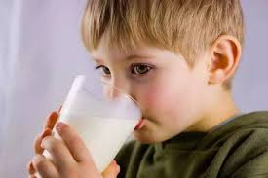
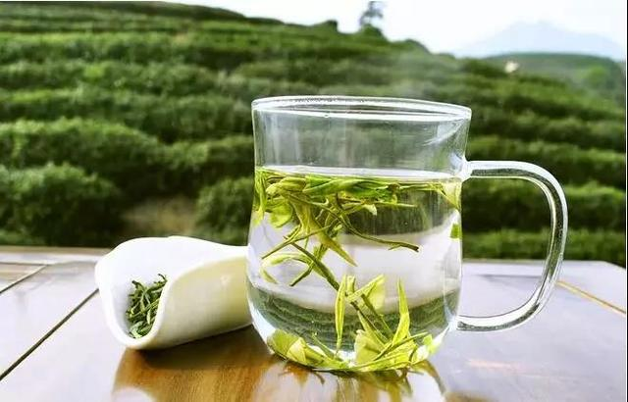
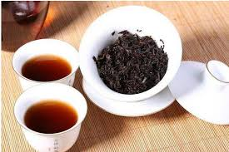
hē niúnǎi
喝 牛奶
hē kāfēi
喝 咖 啡
hē lǜchá
喝 绿 茶
hē hóngchá
喝 红 茶
What would you like to drink?
What’s your preferences for drinks?
Xiǎngyào
想 要 want to
Xǐhuān/bù xǐhuān
喜 欢/ 不喜欢 like/dislike

Slide 4
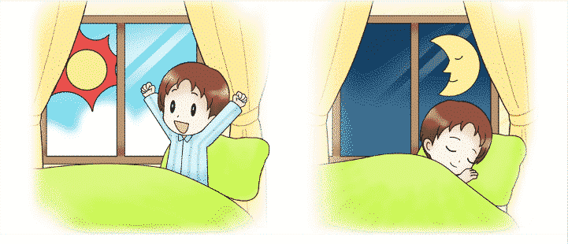
When do you usually get up and go to bed?
qǐchuáng
起 床
shuìjiào
睡 觉
měitiān
每 天 everyday
chángcháng
常常 usually

Slide 5
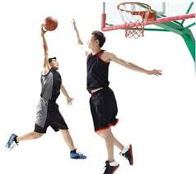
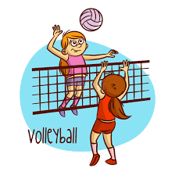
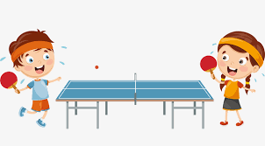
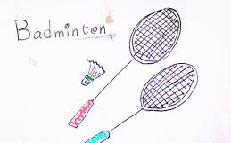
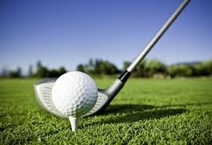
dǎqiú
打球
dǎ lán qiú
打篮球
dǎ pái qiú
打排球
dǎ pīng pāng qiú
打乒乓球
dǎ yǔ máo qiú
打羽毛球
dǎ gāo ěr fū qiú
打高尔夫球

Slide 6
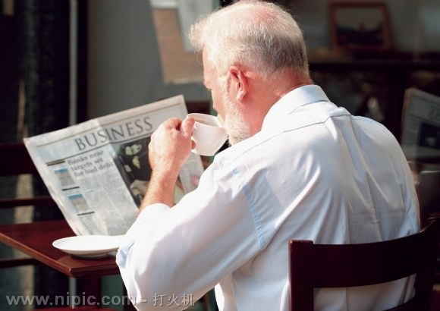
kànbàozhǐ
看报纸
rìbào
日报
zhōubào
周报

Slide 7
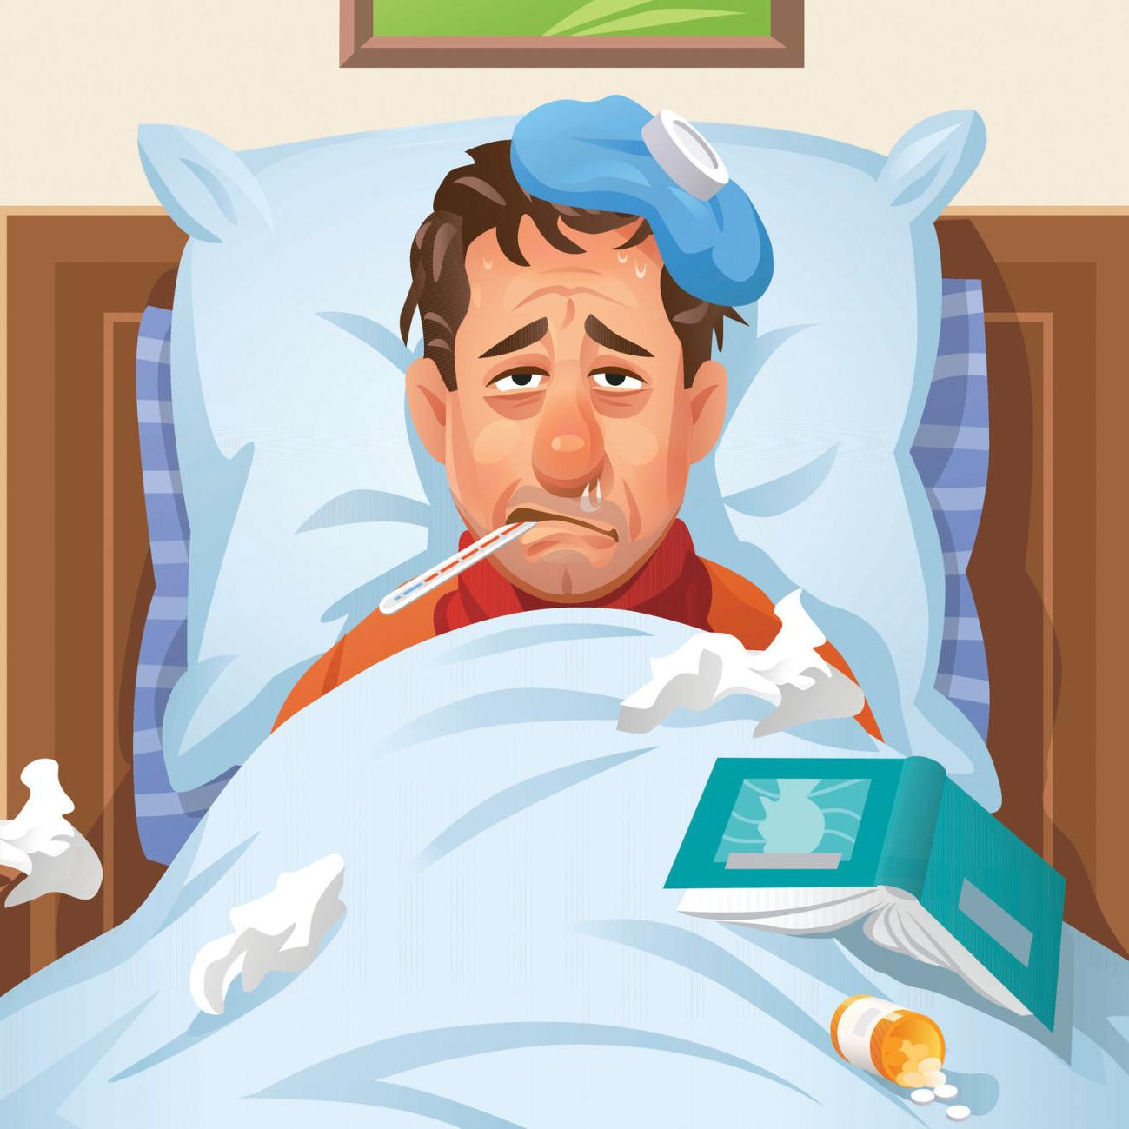
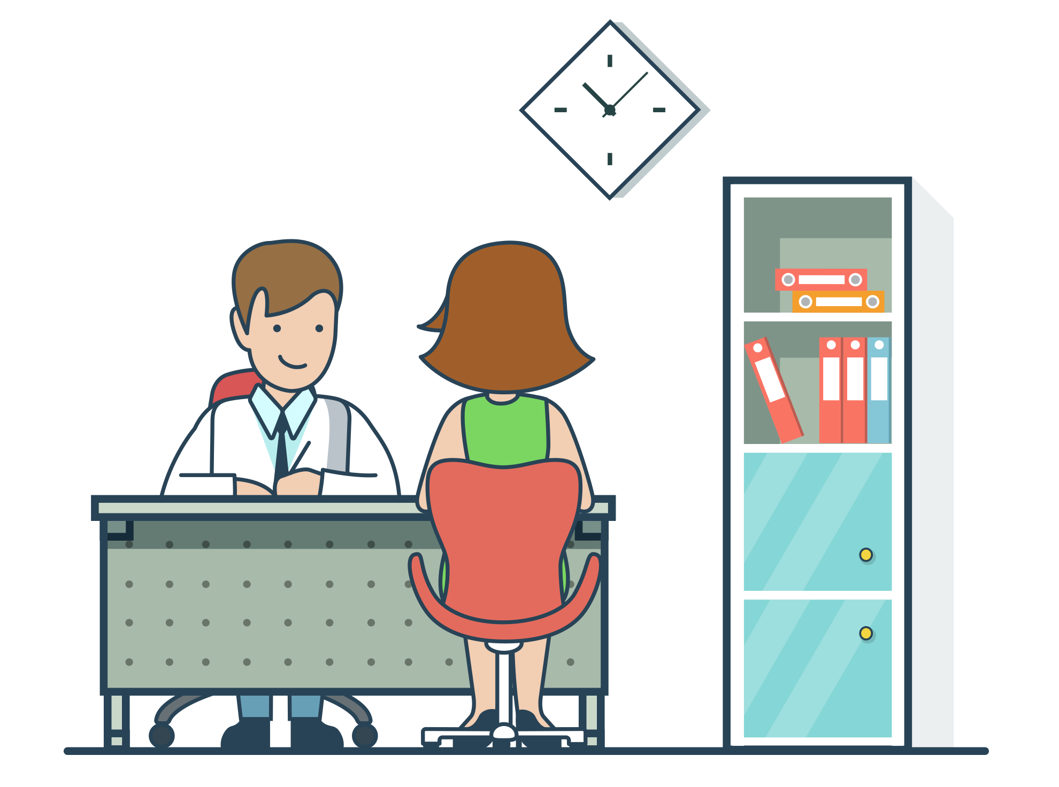
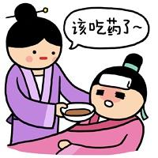
shēngbìng
生病
kànyīshēng
看医生
ànshí chīyào
按时 吃药

Slide 8
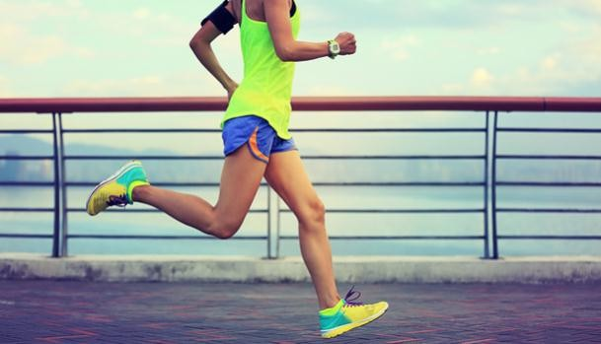
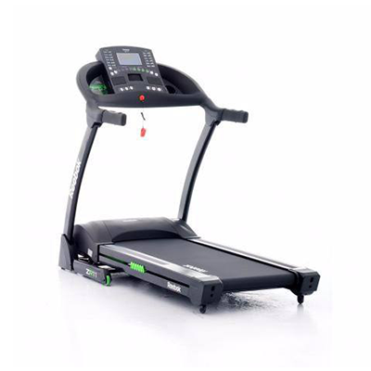
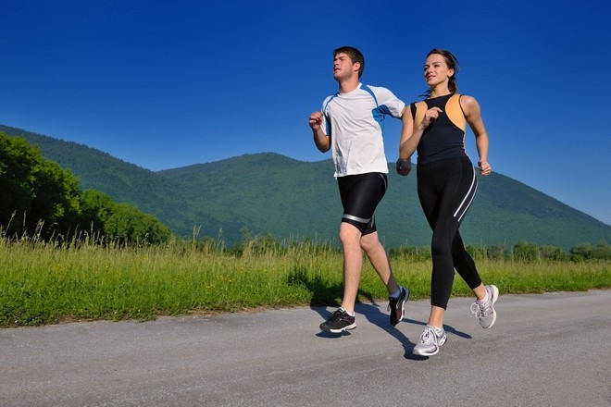
What do you feel like doing for the coming weekend?
pǎobù
跑步
sànbù
散步
pǎobùjī
跑步机
mànpǎo
慢跑

Slide 9
Chinese Radicals:“犭”“心”
quǎn
xīn

Slide 10
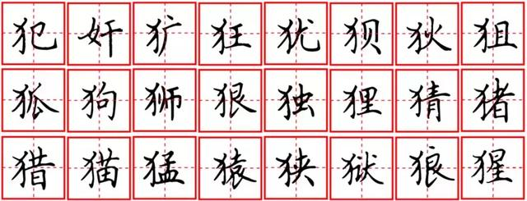

Slide 11
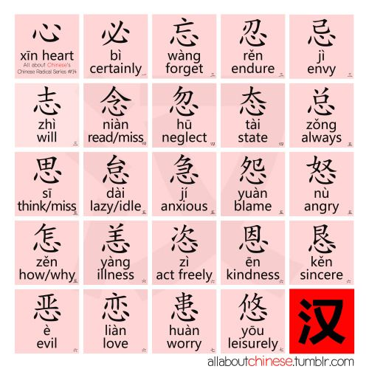

Slide 12
xīn heart

Slide 13
mén door
dàmén
大门
gate
guānmén
关 门
Close the door
kāimén
开 门
Open the door
ménwài
门 外
Outside the door

Slide 15
yáng goat/sheep
shānyáng
山羊
goat
yángnǎi
羊奶
goat milk
yángmáo
羊毛
wool

Slide 17
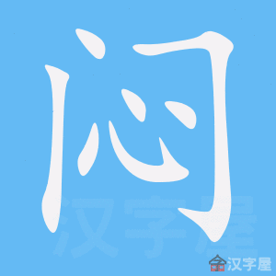
Have a guess

Slide 19
zhīdào知道:know zěnme怎么:how kànjiàn看见:see

