Slide 1
第 8 课
《HSK标准教程》第2册
让我想想再告诉你

Slide 3
(Subj. +) 又(yòu) + Verb + 了le
Yòu xiàyǔ le!
又 下雨 了 ！
It rained again!/ It’s raining again.
Nǐ yòu chídào le.
你 又 迟到 了 。You're late again.
Wǒ yòu wàng le.
我 又 忘 了 。I forgot again.

Slide 4
Wǒ xiǎng zài hē yībēi kāifēi.
我想再喝一杯咖啡。
Wǒ yòu hē le yībēi kāifēi.
我又喝了一杯咖啡。

Slide 5
Reduplication of single-character
Verb + Verb
Indicate that they happen briefly or "a little bit."
Note that for this pattern, the second verb's tone changes to the neutral tone.
看看、想想、说说、听听、走走、逛逛

Slide 6
Verb + 一yī + Verb
xiào yī xiào笑 一 笑 to smile
wèn yī wèn 问 一 问 to ask
yòng yī yòng 用 一 用 use for short time
liáo yī liáo 聊一聊 to chat
cháng yī cháng 尝 一 尝 have a taste
kànyīkàn看一看have a look

Slide 7
Reduplication with Two-Syllable Verbs ABAB
考虑考虑 kǎolǜ kǎolǜ think it over
讨论讨论 tǎolùn tǎolùn discuss it
商量商量 shāngliang shāngliang talk it over
打听打听 dǎting dǎting inquire about it
学习学习 xuéxí xuéxí study a bit
运动运动 yùndòng yùndòng exercise a bit
休息休息 xiūxi xiūxi rest a bit

Slide 8
Reduplication with Separable Verbs AAB
睡睡觉 shuìshuìjiào to sleep
吃吃饭 chīchīfàn eat a bit
喝喝茶 hēhēchá drink a bit
看看书 kànkànshū read a bit
聊聊天 liáoliáotiān chat a bit
逛逛街 guàngguàngjiē go shopping
跑跑步pǎopǎobù running for a while
散散步sànsànbù have a walk
past tense:
A了AB

Slide 10
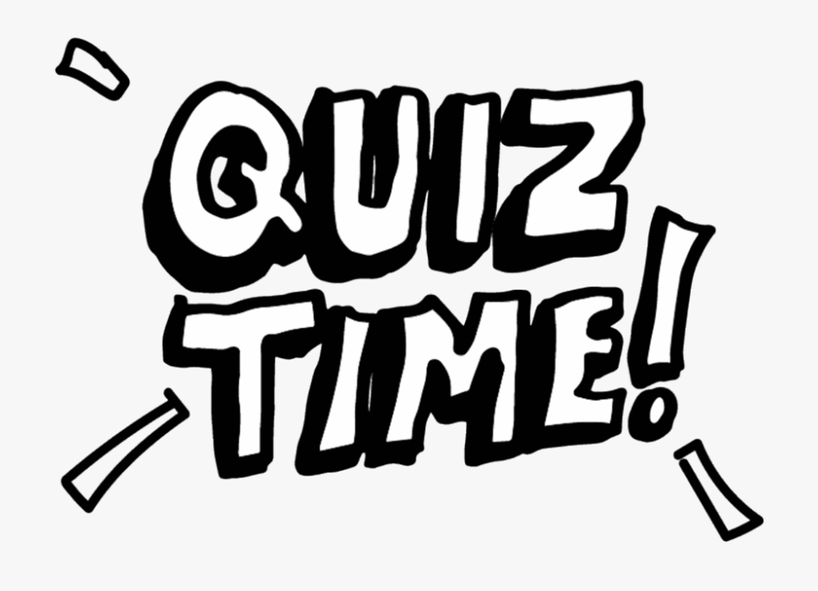
看kàn 听tīng 说shuō 尝cháng
学习xuéxí 运动yùndòng 休息xiūxī
睡觉shuìjiào 吃饭chīfàn 喝茶hēchá
跑步pǎobù

Slide 11
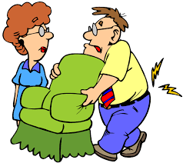
让 (ràng) let
叫 (jiào) ask
请 (qǐng) invite
使 (shǐ) make
sb. / sth. |  | person | do sth
Wǒ jiào rén qù kànkan.
我叫人去看看。
Ràng wǒ zài xiǎngxiang.
让我再想想。
Wǒ yào qǐng nǐ bāng yīgè máng.
我要请你帮我一个忙。
Zhè bù diànyǐng shǐ rén hěn gǎndòng.
这部电影使人很感动。

Slide 12
kànkànshū
看看书
lái kànnǐ
来 看你
xiǎngxiǎng
想想
xuéxí xuéxí
学习学习

Slide 15
Subj. + 再(zài) + [Verb Phrase]
do again
did again
(Subj. +) 又(yòu) + Verb + 了le
You drank a cup of green tea and wanted to have another cup.
Wǒ xiǎng zài hē yībēi lǜchá.
我想再喝一杯绿茶。
You drank another cup of green tea.
Wǒ yòu hē le yībēi lǜchá.
我又喝了一杯绿茶。

Slide 16
Subj. + 再(zài) + [Verb Phrase]
do again
did again
(Subj. +) 又(yòu) + Verb + 了le
The music is so beautiful. You want to listen for one more time.
Wǒ xiǎng zài tīng yībiàn.
我想再听一遍。
You listened for once more.
Wǒ yòu tīng le yībiàn.
我又听了一遍。

Slide 17
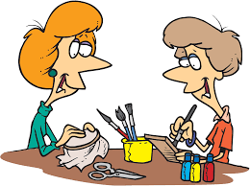
xiào yī xiào笑 一 笑 to smile
Wǒ xiǎng xiūxi xiūxi.
我 想 休息 休息。
Wǒ xiǎng cháng yī cháng.
我 想 尝 一 尝。
Nǐ yòu chídào le.
你 又 迟到 了 。
When someone is sad. You can say.
When someone is late again.
When you feel tired and want to take a rest.
When you want to taste something.

