Slide 1
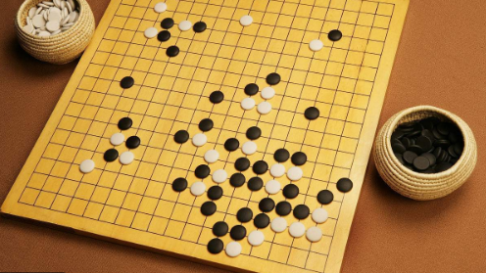
Chinese traditional games

Slide 2
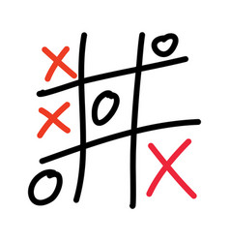
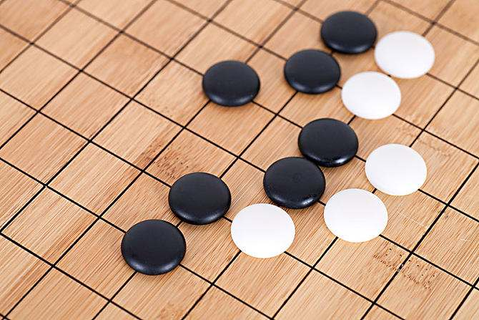
五子棋 Five in a Row/Gomoku
Wǔ zǐ qí
Traditionally played with black and white pieces made of stones.
It is played using a 15x15 board.
Also be played as a paper-and-pencil game.
Originated in China, developed in Japan

Slide 3
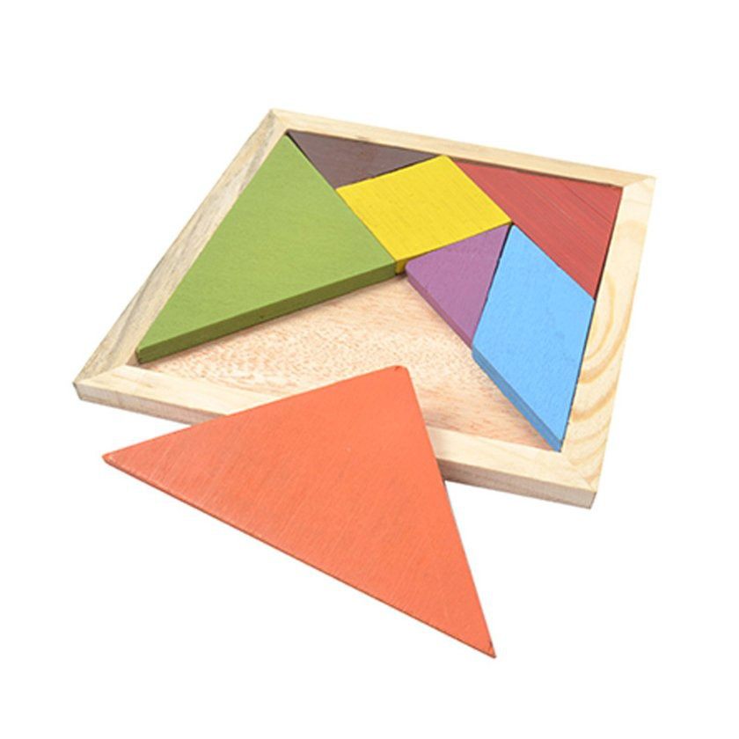
七巧板 Tangram
Qi qiǎo bǎn
Originate in China during Qing and Ming dynasties.

Slide 4
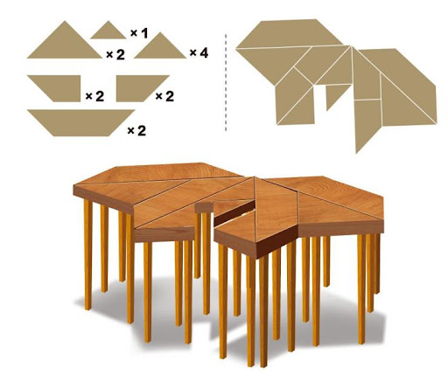
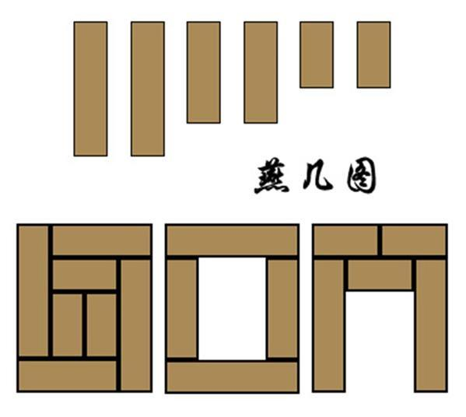
Developed from 燕几图 in Song dynasty to 翅几图 in Ming dynasty to modern 七巧板.
燕几 is the table to host guests.
翅几 is the guest table looks like a buttle fly.
翅几图

Slide 5
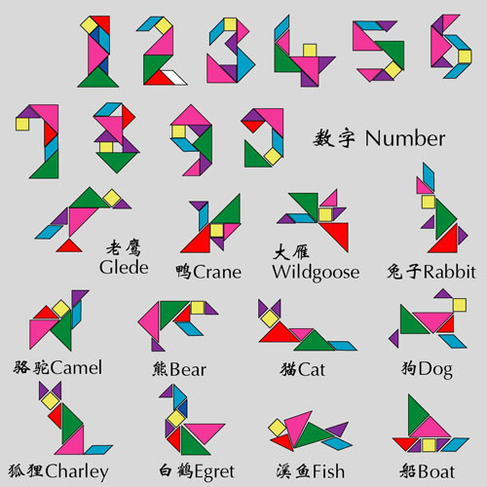
七巧板

Slide 6
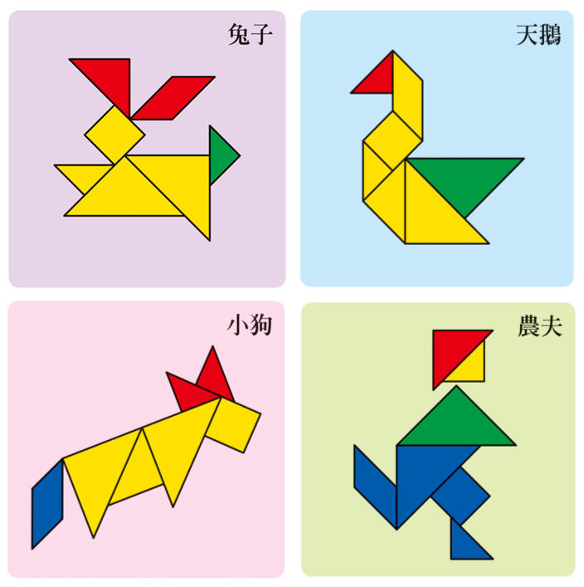
七巧板

Slide 7
七巧板

Slide 8
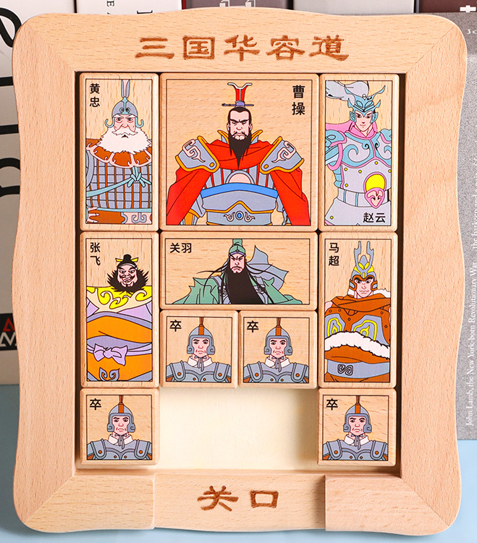
huá róng dào
华容道 Sliding Blocks of Huarong
Sliding block puzzle
several different-sized block pieces
are placed inside a box
A special one(largest) which must be
moved to a special area.

Slide 9
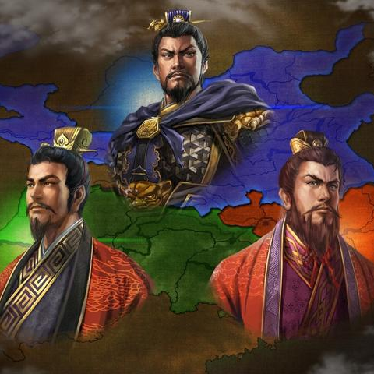
Name after one of the story from Three Kingdoms
from 220 to 280 AD was the tripartite division of China among the states of Wei, Shu, and Wu.
The Three Kingdoms period started with the end of the Han dynasty and was followed by the Jin dynasty.

Slide 10
the story of Three Kingdoms(4mins)

Slide 11
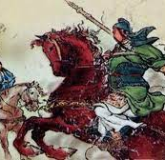
The story of Huarongdao
In the year 208 Cao Cao led 220,000 troops of the Wei army to fight against an army of 50,000 Shu troops in a mountainous area near Chibi in today’s Hubei province. Because of some strategic errors, Cao Cao’s troops were badly defeated in the Battle of Chibi, and he fled with only a handful of his soldiers.

Slide 12
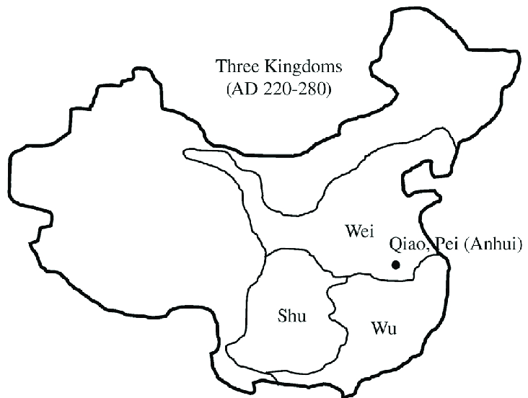
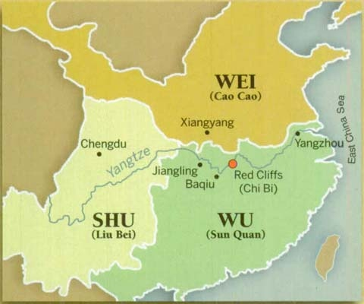
The map of Three Kingdoms
help Caocao, which is the ruler of Wei, to escape

Slide 13
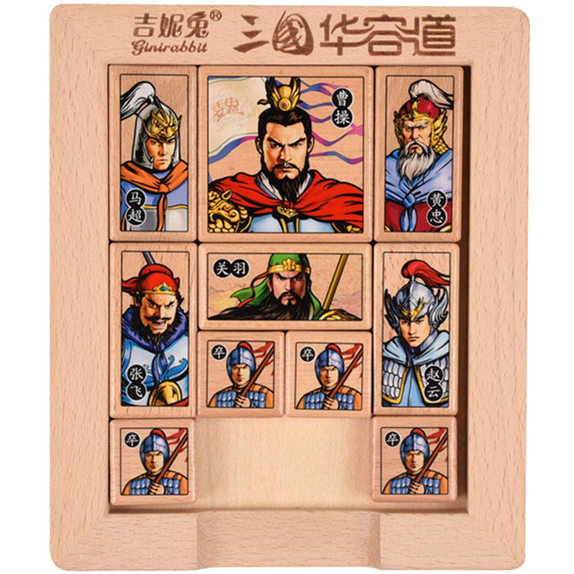
The historical characters in this game
Caocao,the ruler of Wei
Huangzhong,general of Shu
Zhaoyun,general of Shu
Zhangfei,general of Shu
Machao,general of Shu
The rest are soldiers
Guanyu,general of Shu

Slide 14
How to play Huarongdao?
Take the least step helping Caocao to escape
Use the least time helping Caocao to escape

Slide 15
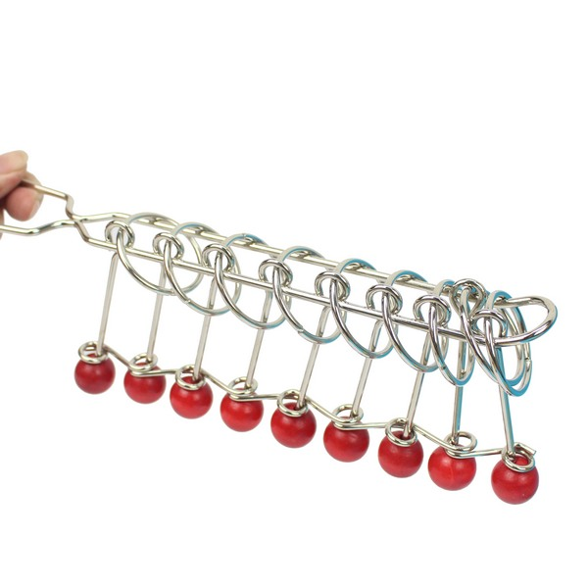
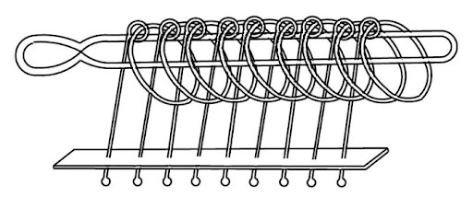
九连环 Chinese ring’s puzzle
Jiǔ lián huán
consists of a long loop with a handle on one end that is interlocked with nine rings.
The objective is to disentangle the long loop from all nine rings

Slide 16
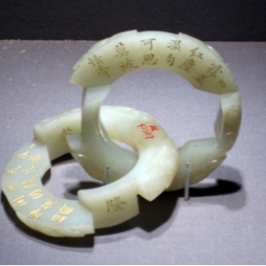
One of the stories of 九连环
A Han dynasty (206 BCE–220 CE) history of the Warring States period contains a story that involves King Zheng of the Qin kingdom, the man who would later become Qin Shi Huang, the first emperor of China. King Zheng sent an emissary to present a set of jade linked rings to the Empress Dowager of the Qi Kingdom. The king’s message said, “The Qi people are quite intelligent, but can they untangle these rings?” The Empress showed the rings to her ministers, but none of them could untangle the rings. The Empress then took a hammer and broke the rings. She thanked the emissary from Qin and said, “Now they’re untangled!”

Slide 17
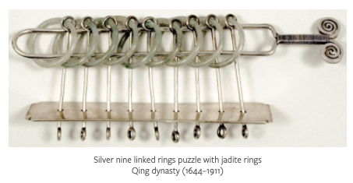
九连环 has become a popular and common puzzle game for everyone today
In the year 1713 of the Qing dynasty (1644–1911) Emperor Kangxi (reigned 1662–1722) was given a jade nine linked rings for his sixtieth birthday by the third daughter of his seventh son, Prince Chun.
Pu Yi (1906–1967), who assumed the throne in 1908 at the age of three to become the last emperor of the Qing dynasty, owned a beautiful silver nine linked rings puzzle with rings of jadeite.

Slide 18
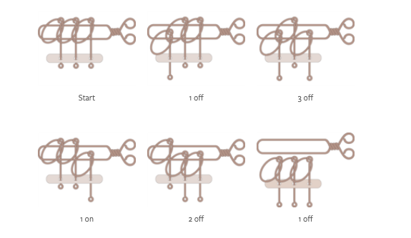
The solution of 九连环
A procedure for solving the nine linked rings puzzle is based on the fact that at any given moment there are exactly two rings that can be taken off or put on the handle.
Take a three linked rings puzzle as example
Rule A. Ring 1 can always be taken off or put on the handle.
Rule B. The only other ring that can be taken off or put on the handle is the ring immediately after the lead ring, where the lead ring is defined as the first ring that is on the handle.

Slide 19
How to play 九连环？

