Slide 1
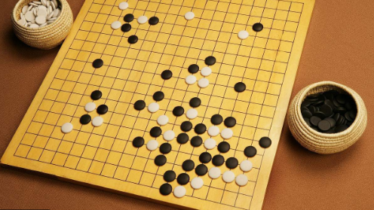
Chinese traditional games

Slide 2
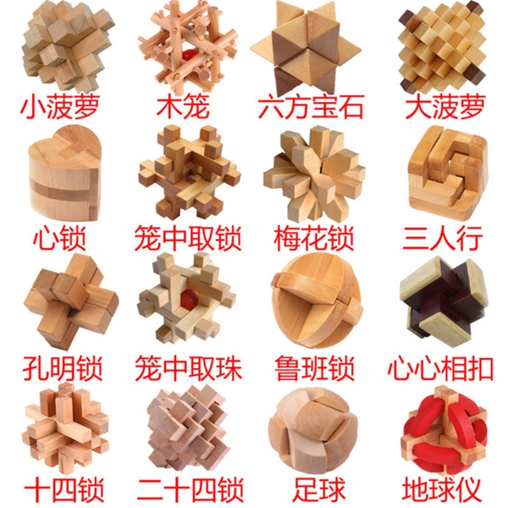
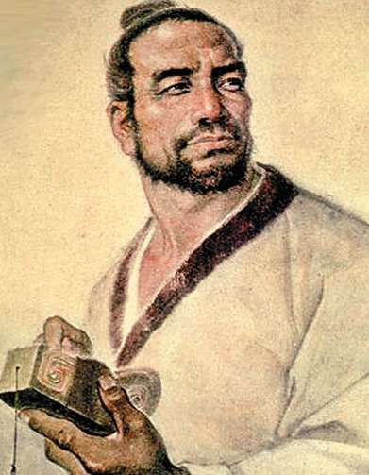
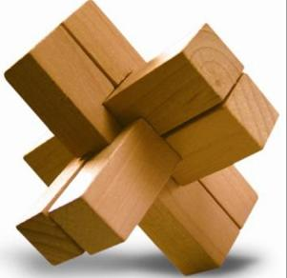
鲁班锁（Luban lock）
Lǔ bān suǒ
Lu Ban( 507–444 BC)（3000 years ago） was a Chinese structural engineer, inventor, and carpenter during the Zhou Dynasty. He is revered as the Chinese Deity of builders
The concave(凹) and convex（凸） parts inside the three-dimensional interpolation toy mesh perfectly. Luban locks come in different shapes and sizes, with different internal structures.

Slide 3
TODAY’S Luban Lock

Slide 4
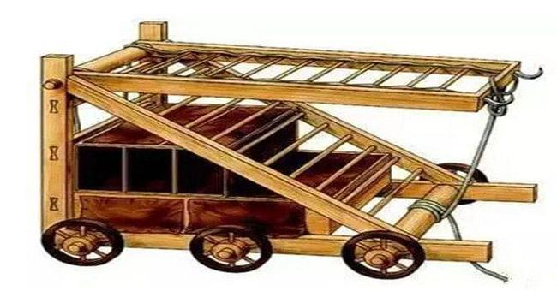
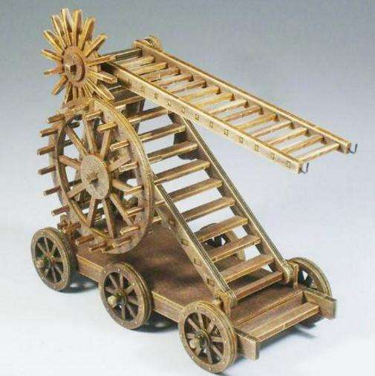
Luban’s some other inventions
Cloud ladder—a mobile, counterweighted siege ladder.

Slide 5
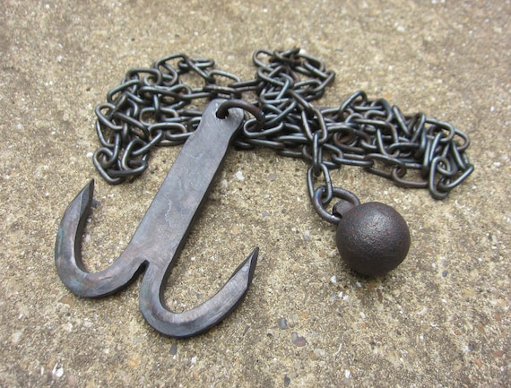
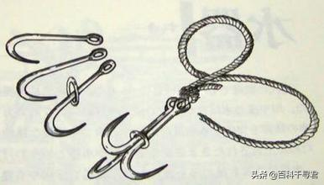
Grappling hooks —implements for naval warfare.

Slide 6
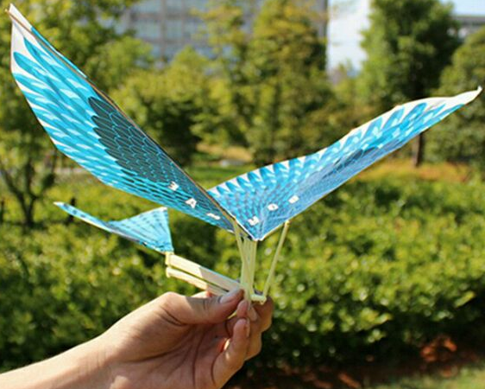
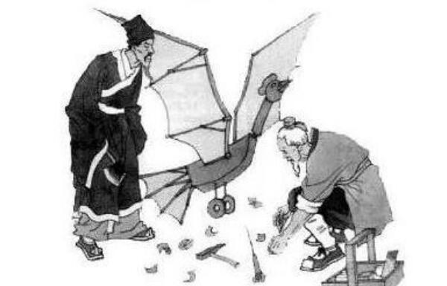
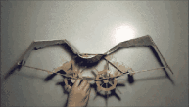
Wooden bird—a non-powered, flying, wooden bird which could stay in the air for a very long time. It has been suggested to be a prototype of a kite.

Slide 7
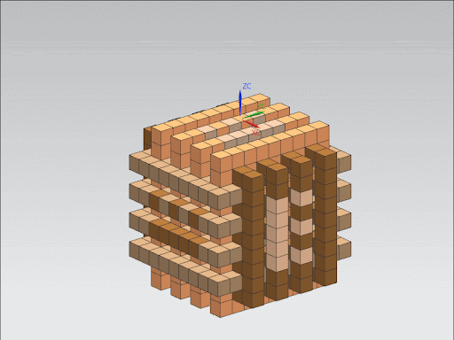
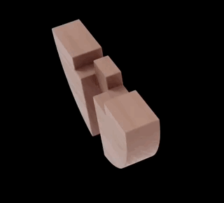
How to unlock a luban lock?

Slide 8
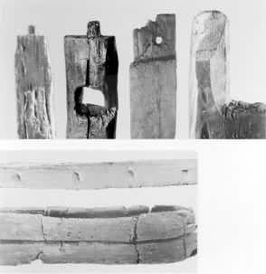
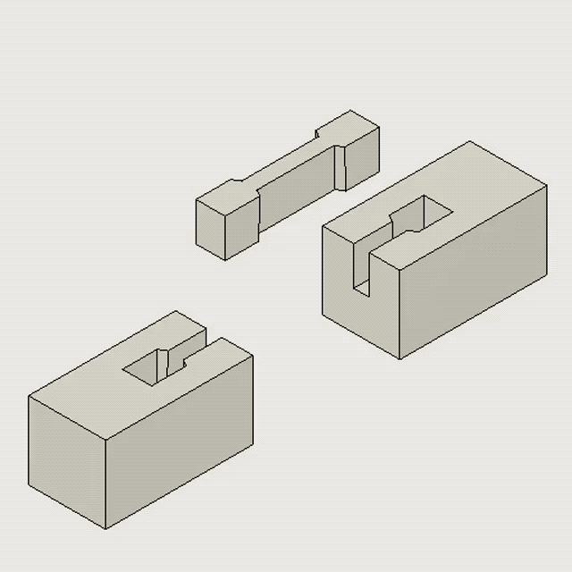
榫卯 Luban lock is the foundation of tenon-and-mortise joint
In ancient China, buildings contained no nails, and were instead built using the mortise and tenon joint process, a concave-convex connection method used to combine two pieces of wood.

Slide 9
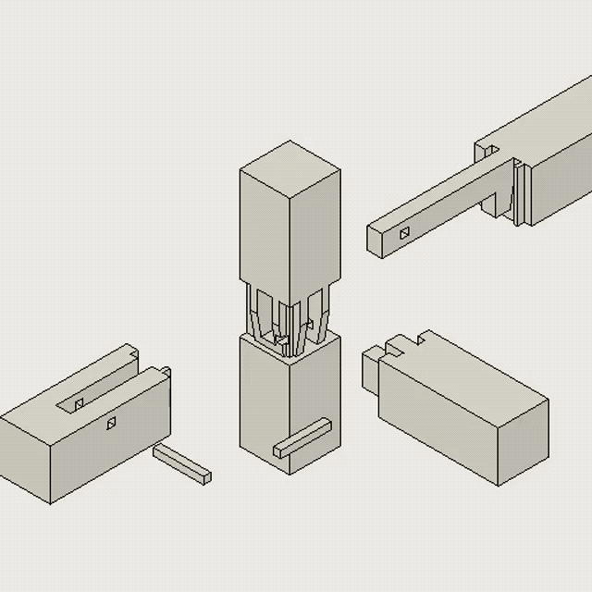
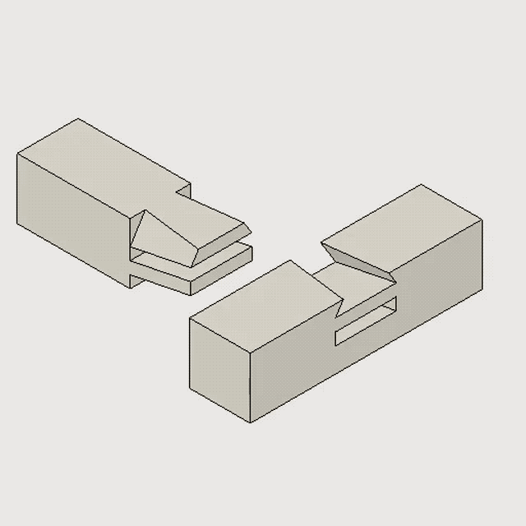
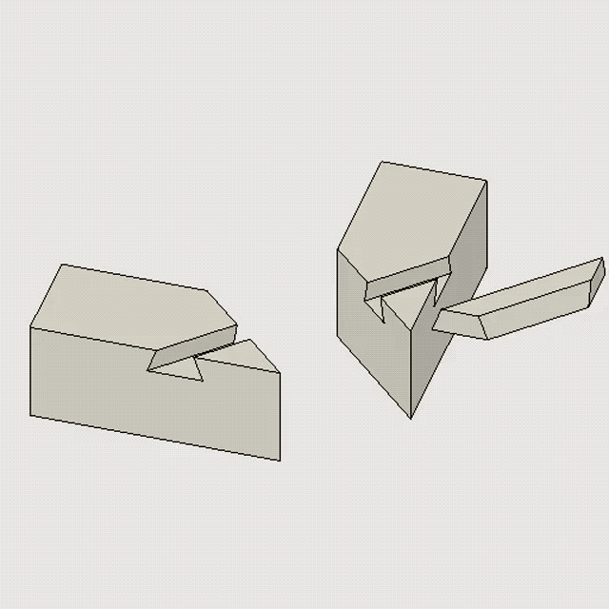
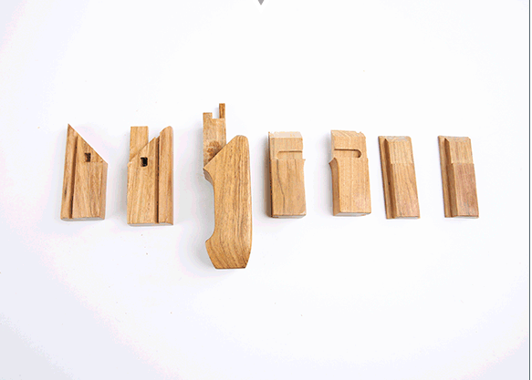
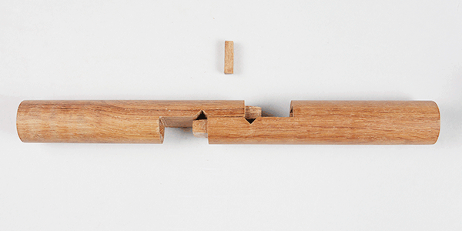

Slide 10
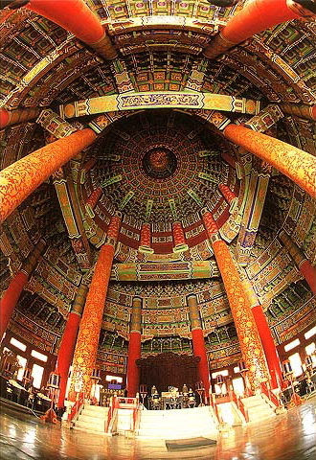

Slide 11
