Slide 1
Father’s Day Big hug Card
By Di Wang
10/08/2018

Slide 2
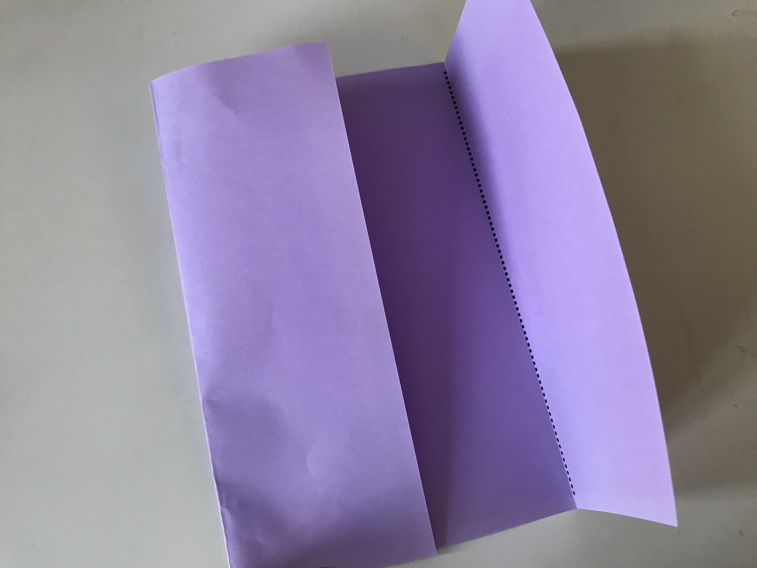
Step 1
Step 1
1. Get a copy of ‘big hug to my dad card’ on the colour paper and fold along the dot line.

Slide 3
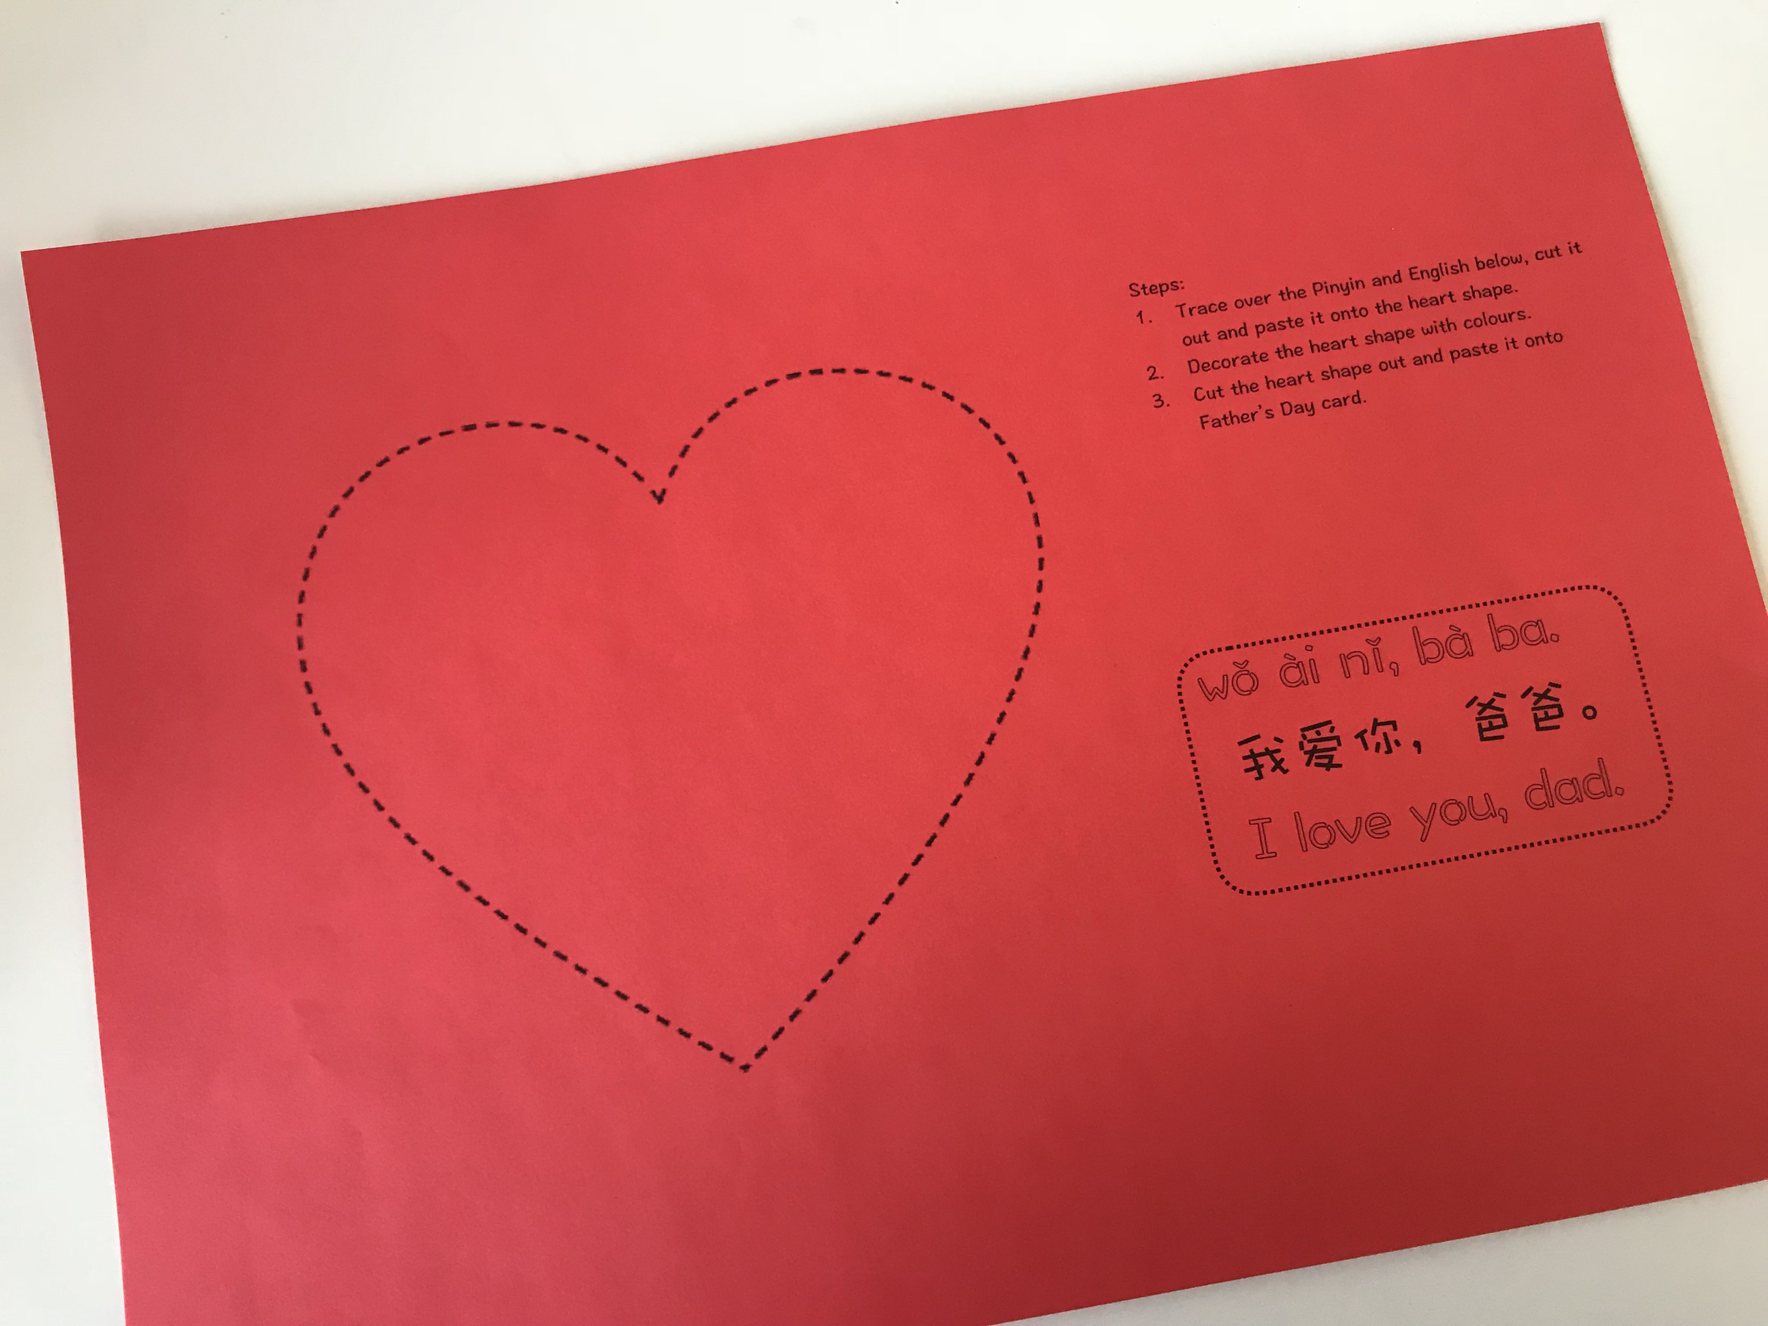
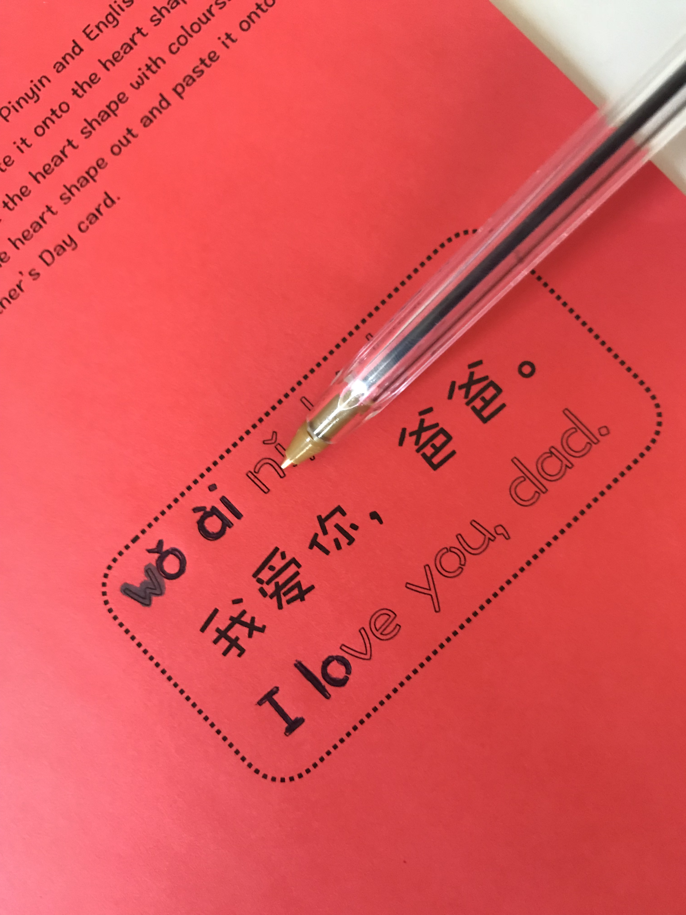
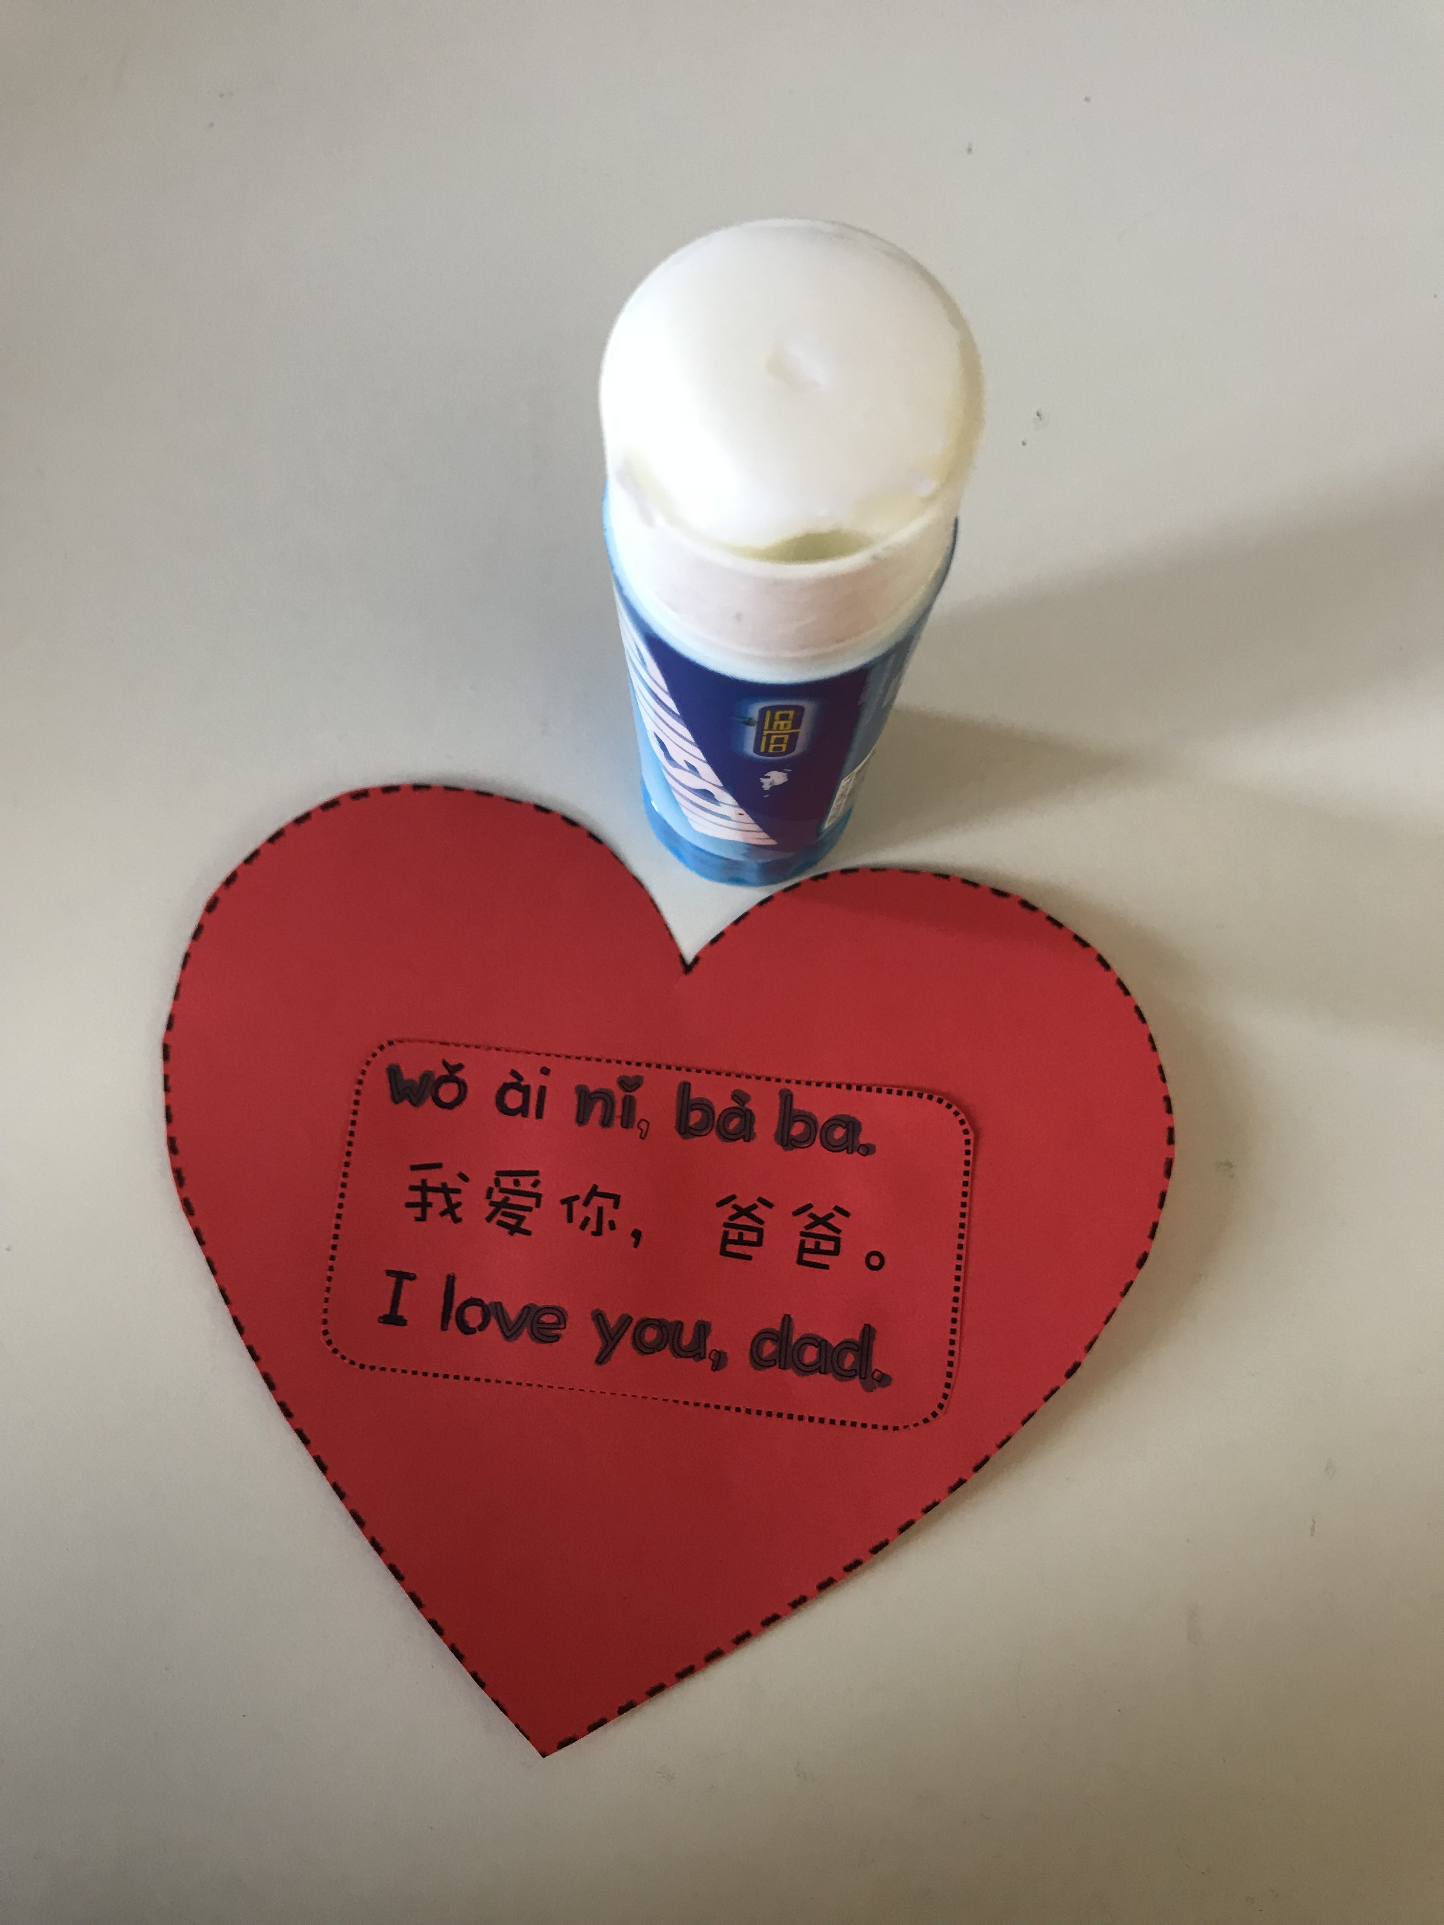
Step 2
Step 2
Get a copy of ‘heart shape’ on the colour paper.
Trace over the Pinyin and English (this step can be skipped depends on how much time left)
Paste the text onto heart shape.

Slide 4
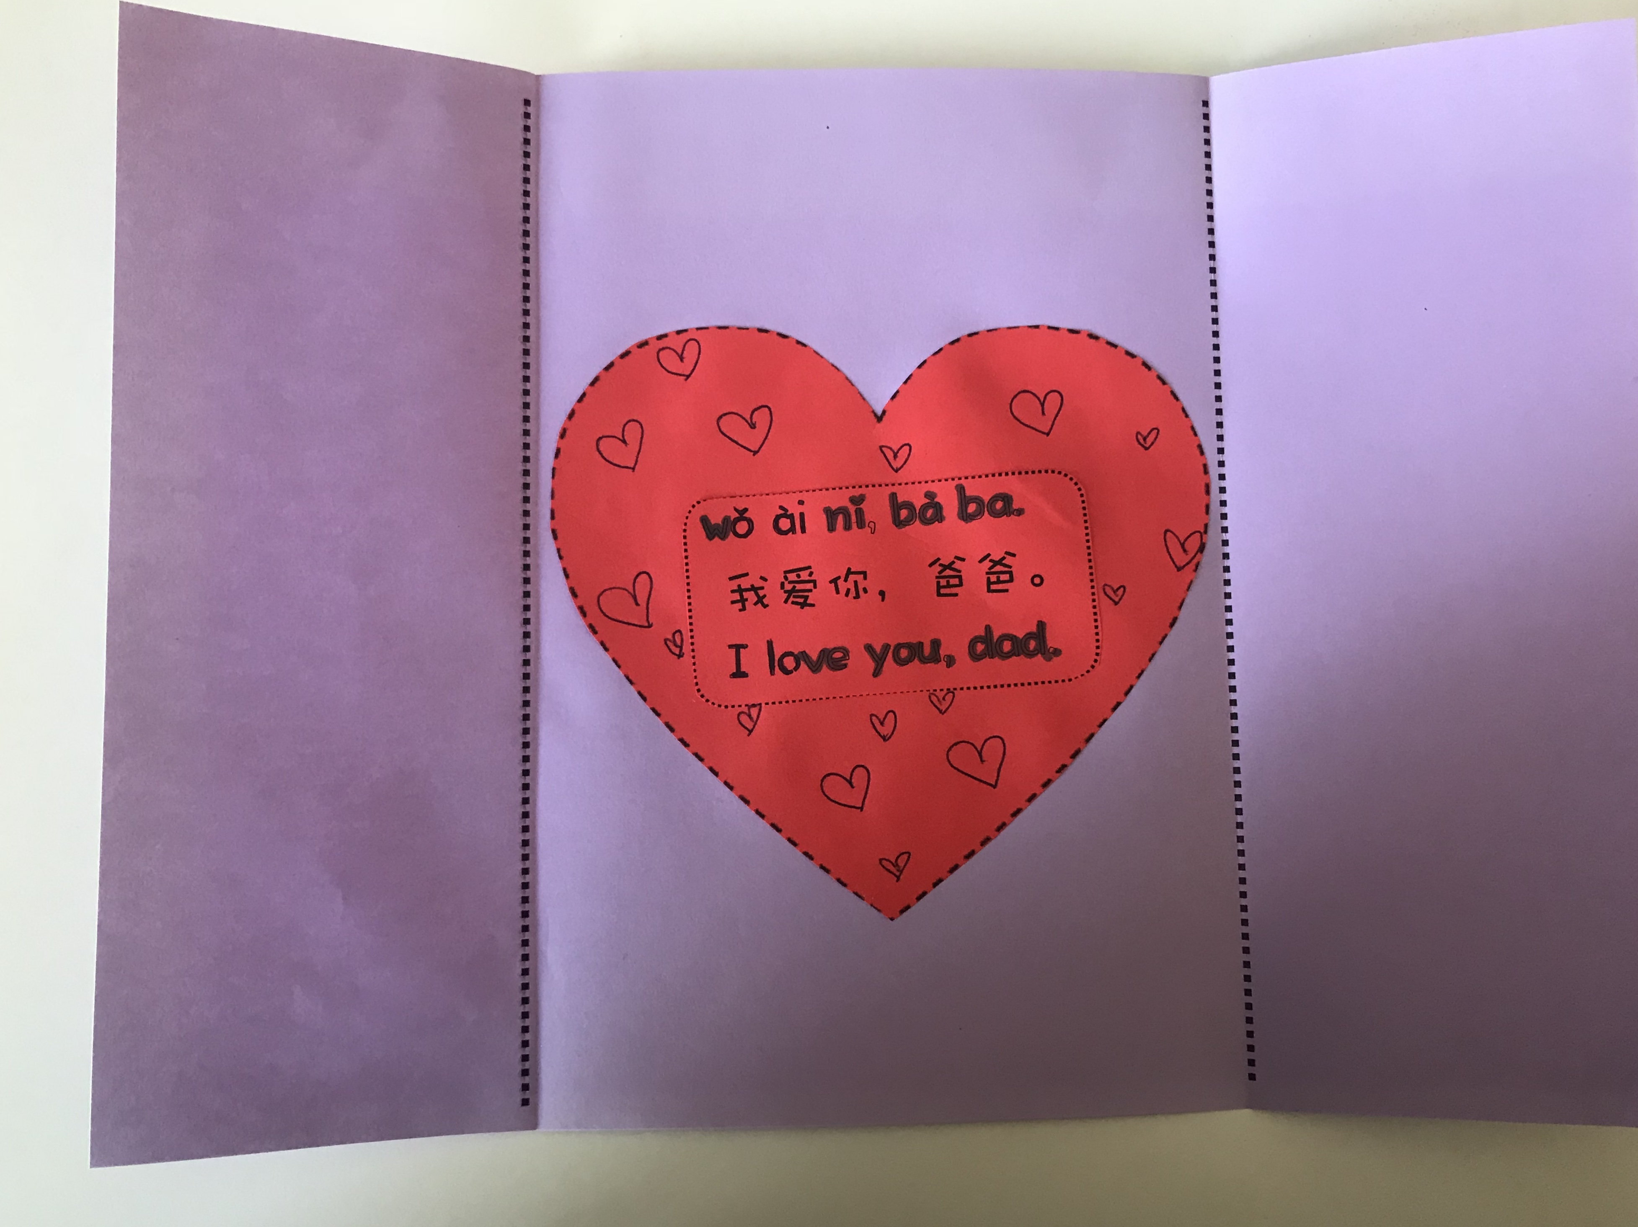
Step 3
Step 3
1. Paste heart shape onto the card.

Slide 5
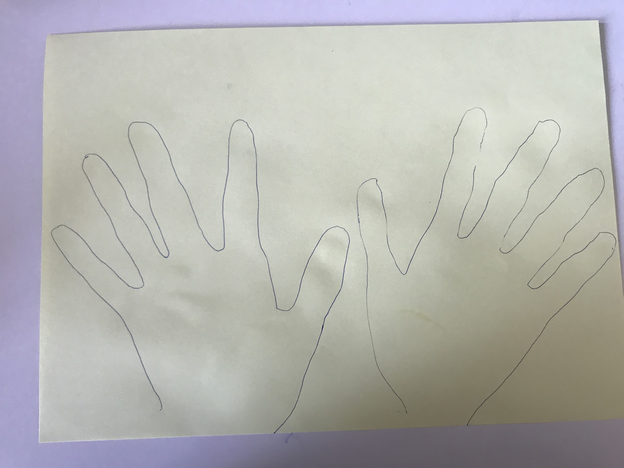
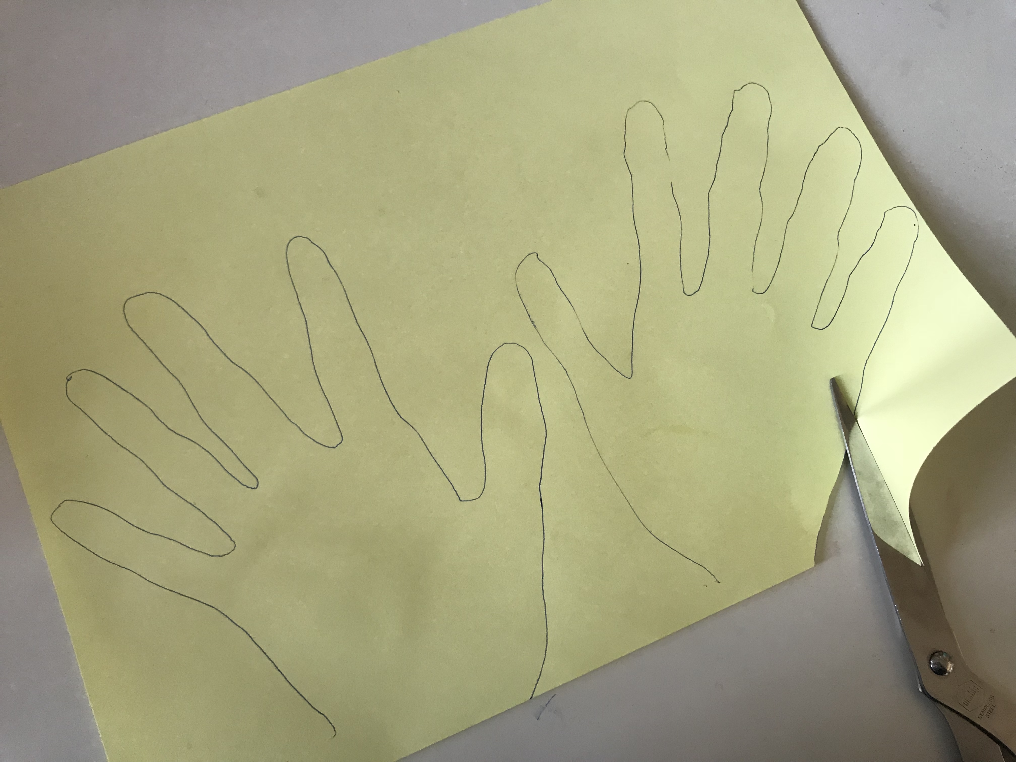
Step 4
Step 4
Draw two hands on colour paper.
Cut hand shapes out.

Slide 6
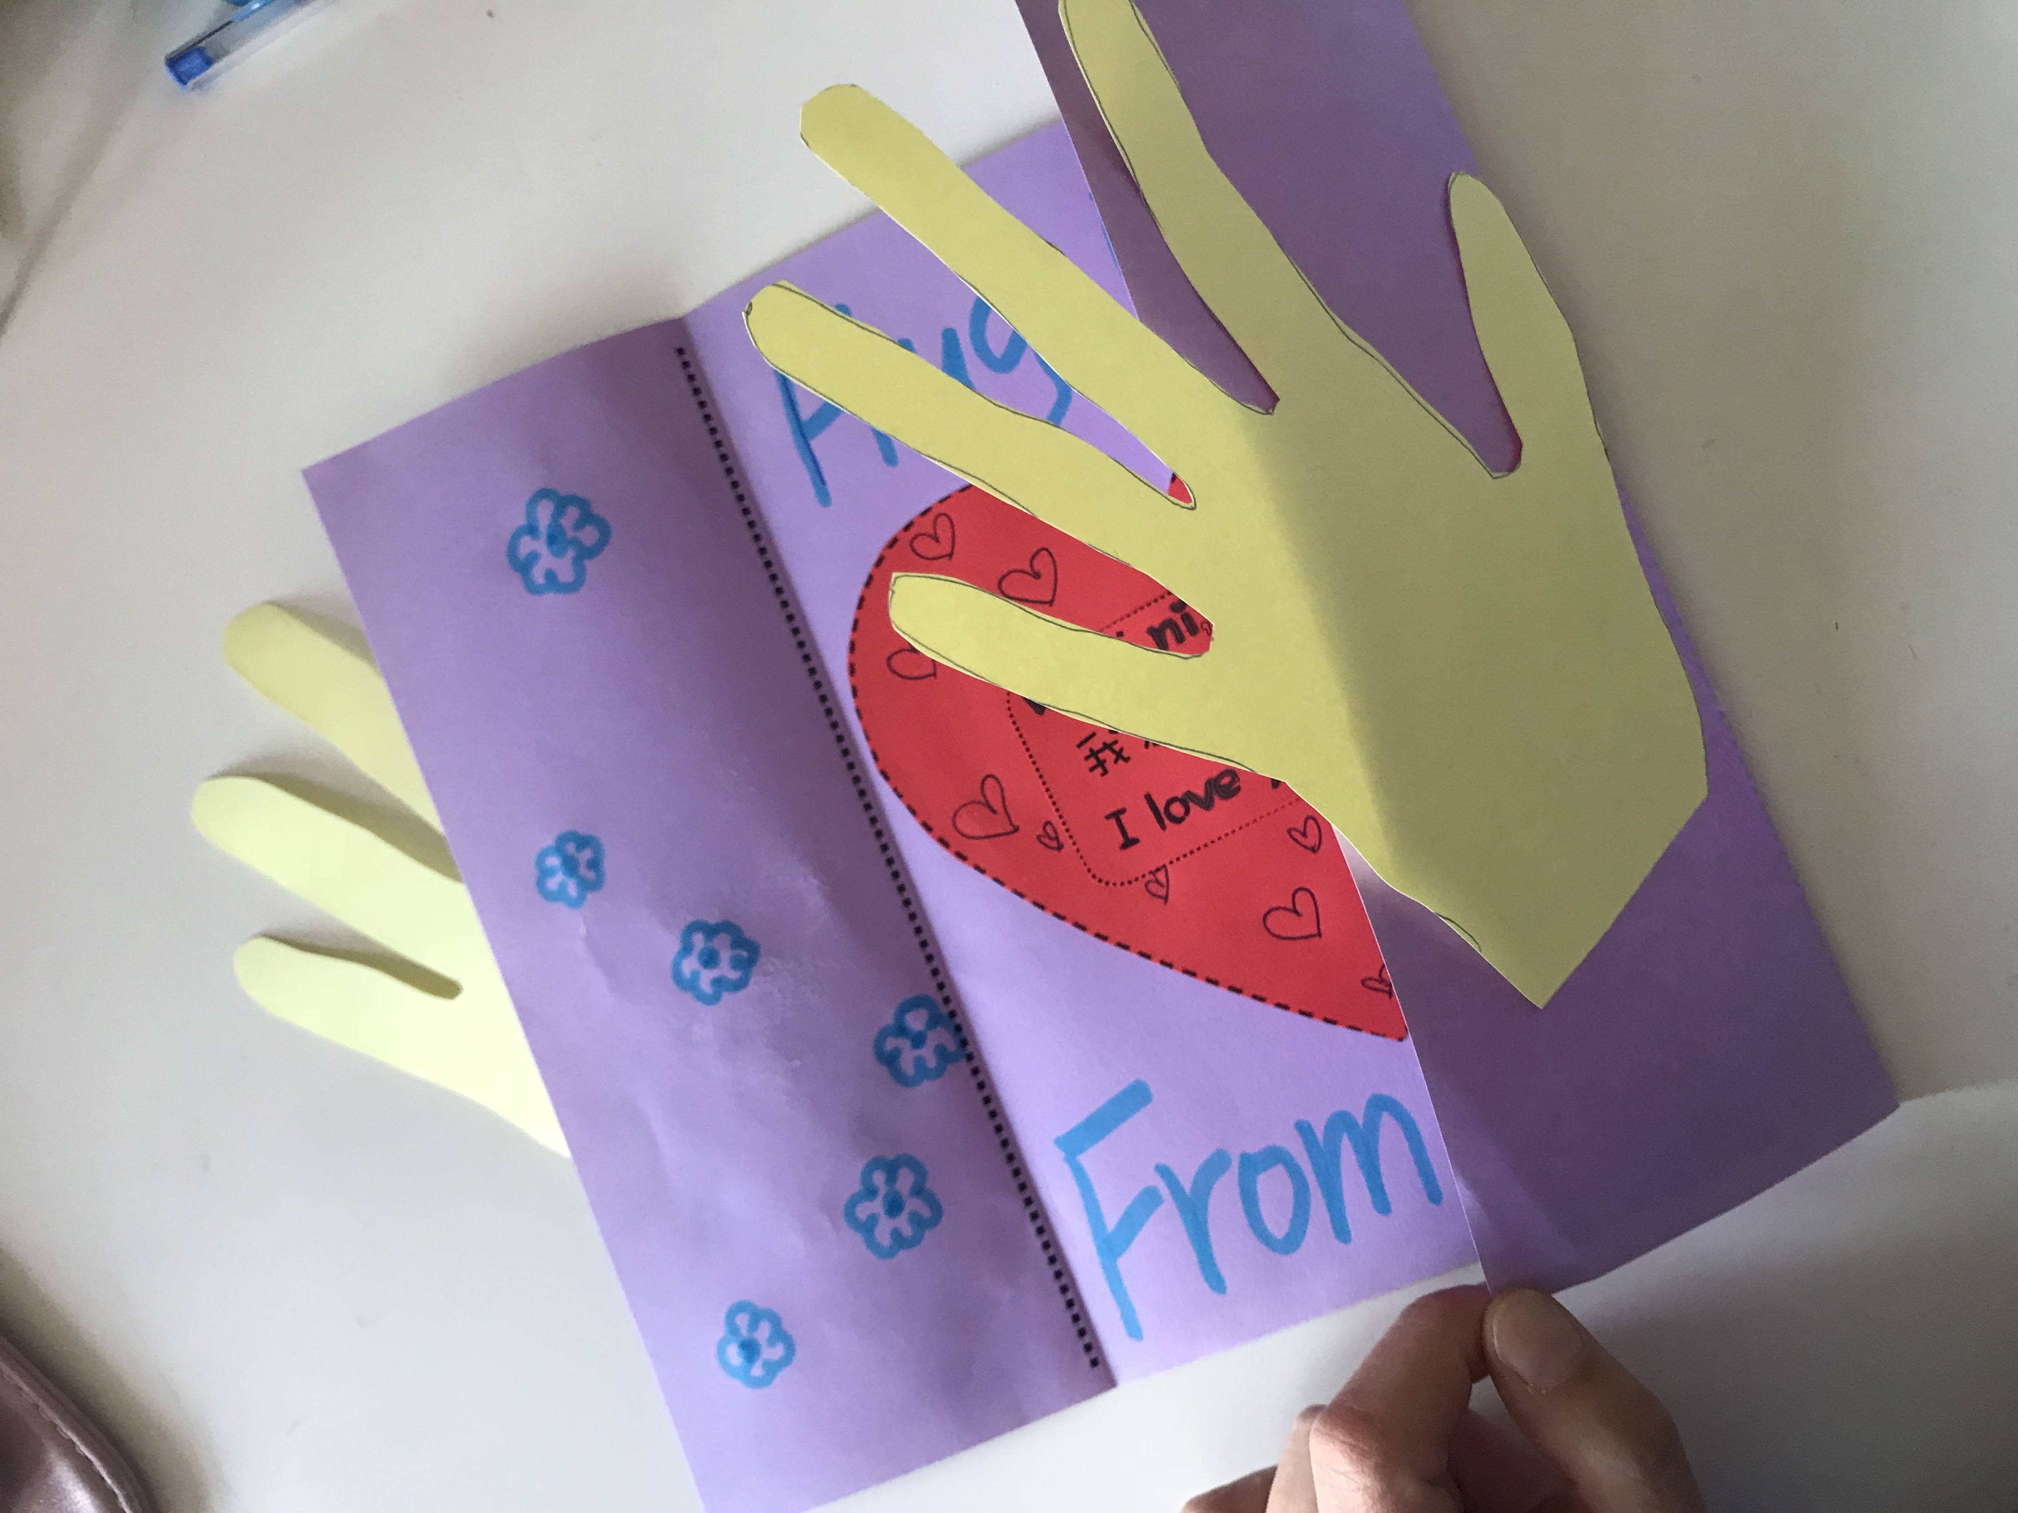
Step 5
Step 5
Paste hand shapes onto card.
Decorate the cards by drawing and writing the message.

