Slide 1
xìng míng míng zì
姓名 VS 名字
Full name
name

Slide 3
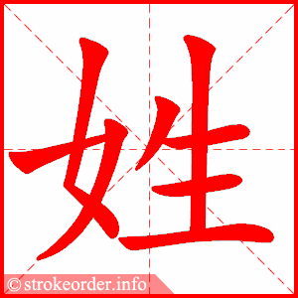
xìng
family name

Slide 4
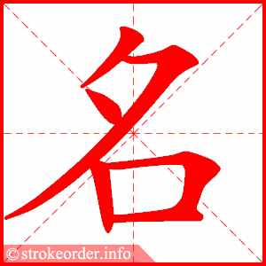
míng
given name

Slide 5
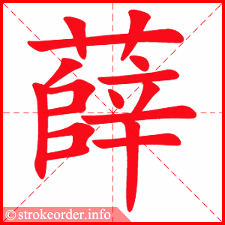
xuē
A family name

Slide 6
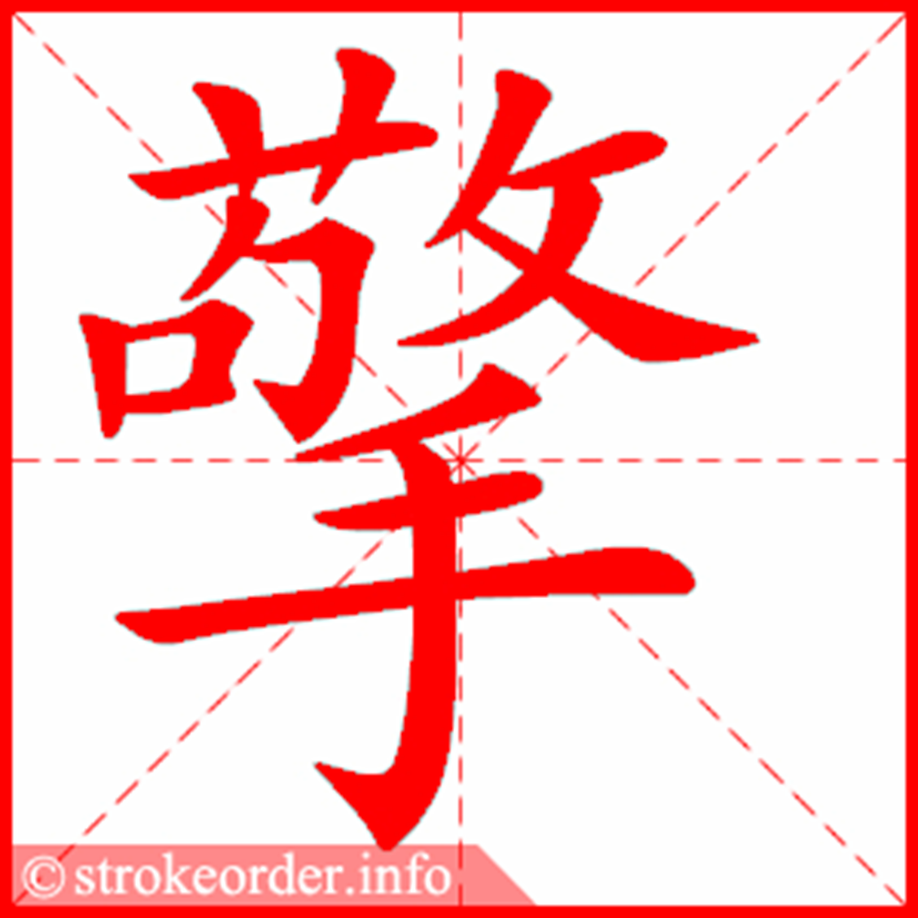
qíng
lift up,
hold up,
support

Slide 7
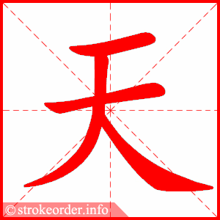
tiān
sky

Slide 8
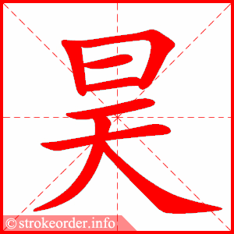
hào
sky,
heaven

Slide 9
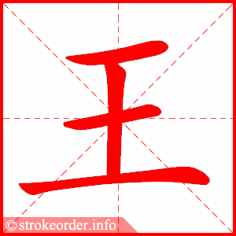
wáng
king,
surname

Slide 10
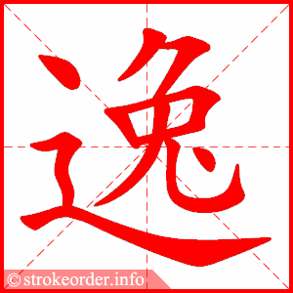
yì
ease,
relaxing

Slide 11
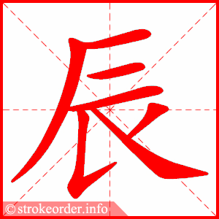
chén
early morning

Slide 12
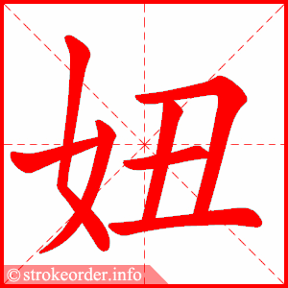
niū
girl

Slide 13
zhào
A family name

Slide 14
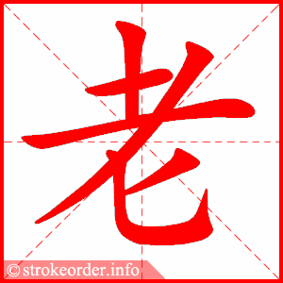
lǎo
old

Slide 15
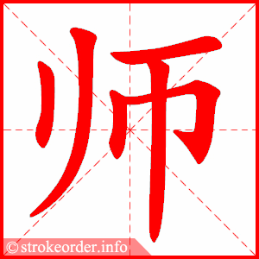
shī
teacher,
master

