Slide 1
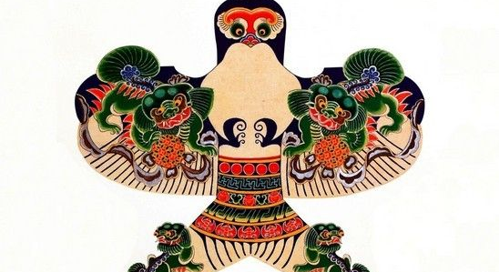
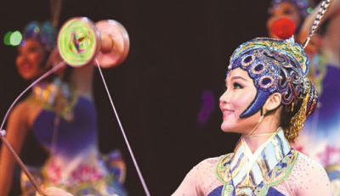
Traditional sports in China
中国传统运动
chuántǒng

Slide 2
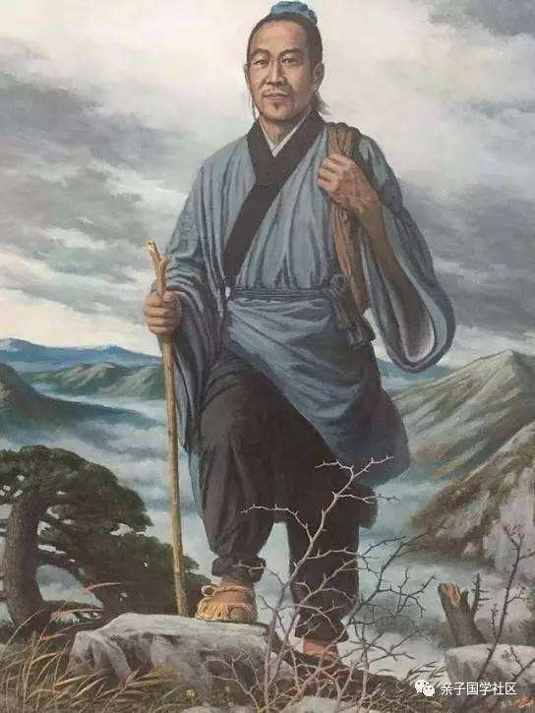
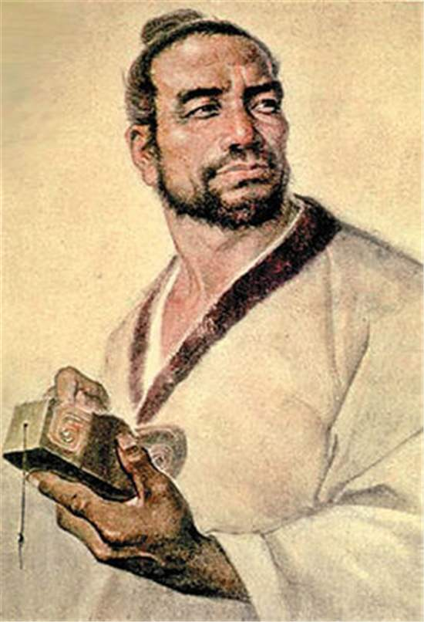
fēngzheng
风筝
中国
2,300年前
Measure distance
Lu Ban
Mo zi
Provide information
Calculate the wind level
Notes:
Reference: Kites were invented in China about 2,300 years ago by two philosophers, Mozi and Lu Ban, we didn't have cameras back to 2000 years ago, so maybe this is how they look like, man and women all had long hairs 2000 years ago. Kites were first made to measure distance, providing information to aid moving large armies across difficult terrain. They were used to calculate and record wind readings, similar to ship flags at the sea. The greater the wind blowing, the higher the flags flying.

Slide 3
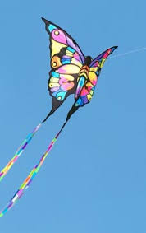
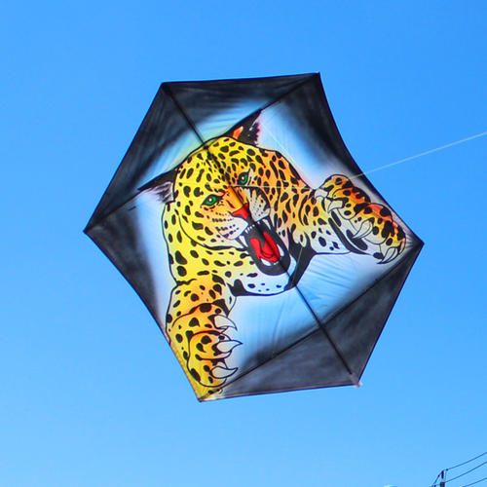
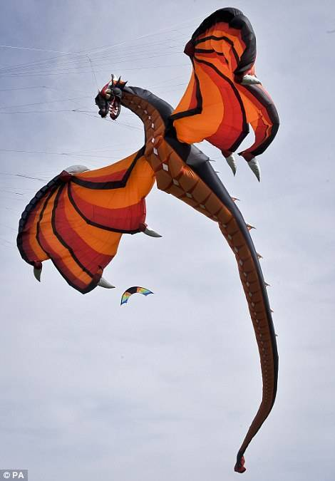
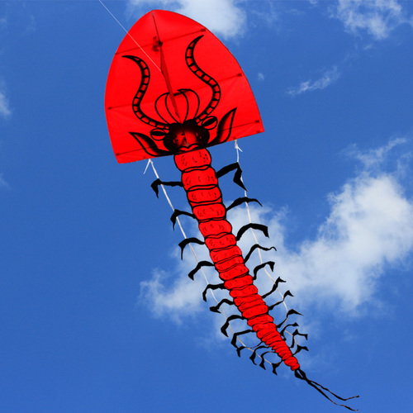
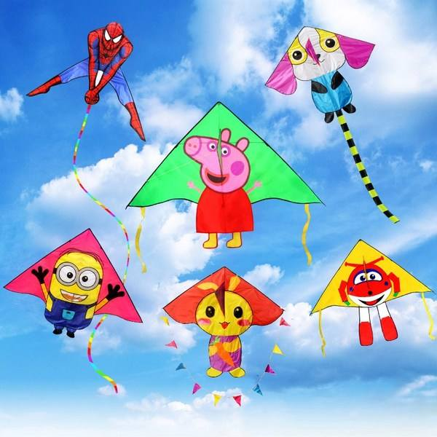
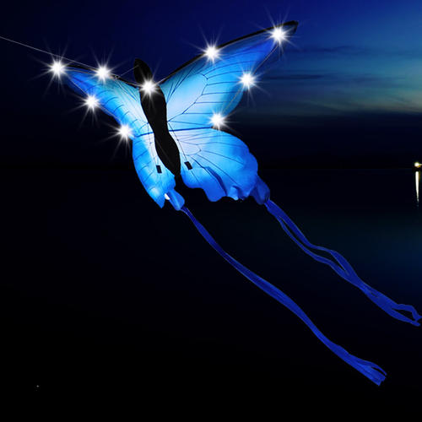
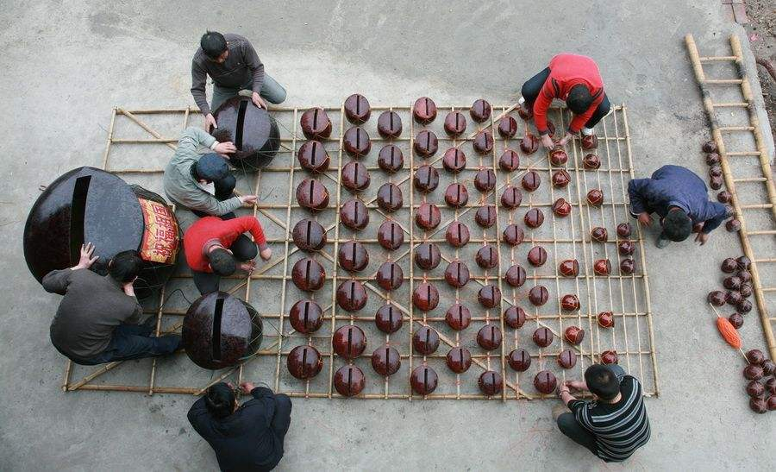
leìxíng 风筝的类型
Hard-wing kites & Soft-wing kites
Flat kites & Inflatable kites
Whistle kites & LED kites
Centipede & Cartoon kites
Notes:
Reference: 1. You can draw the patterns you like on the hard wings. Soft-wing kites are the kites with soft fluttering wings, you can see the wings fluttering in the sky. 2. We have kites can make noise when flying in the sky because they are equipped with special gadgets. LED kites are the kites decorated by lights so you can still see them in the sky in the dark. 3. Centipede kites are the kites with long and soft body,maybe with many legs as well, it can be a centipede itself, even a snake or a dragon.

Slide 4
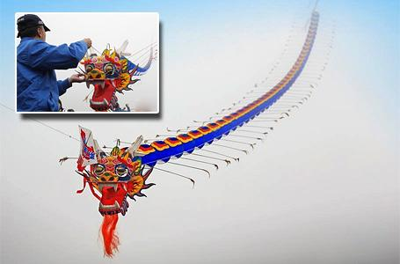
世界上最长的风筝有 6, 000米.
和30辆火车一样长。人们花2年制作。

Slide 5
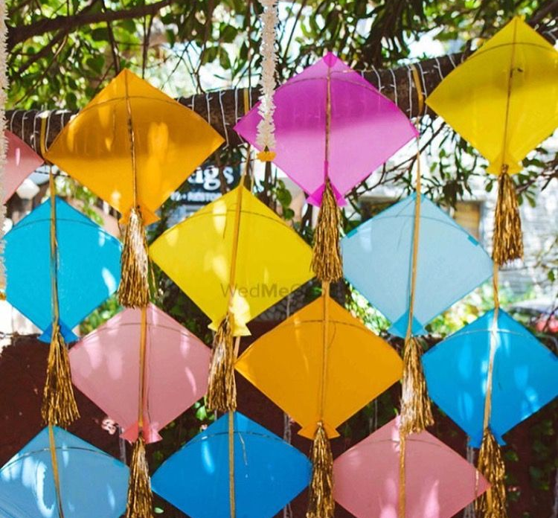
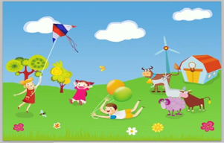
在中国，为什么人们喜欢风筝?
Drive off bad luck
Beautiful decorations
Family fun activity
Notes:
Reference: 1. There are some good symbols on kite. For example, swallows mean good luck and peaches mean long life. Don't worry if the kite string is broken, and the kite flies away, that means the bad luck is driven off. Some people cut off the kite string on purpose when they fly the kite because they have been feeling down recently, and they want the kite take the bad luck away from them. 2. Kites can also be the decoration of your house, the restaurant or the garden. 3. When it is Spring in April, the weather is good for flying kites. Flying a kite in the garden or river beach is a common activity for families and friends.

Slide 6
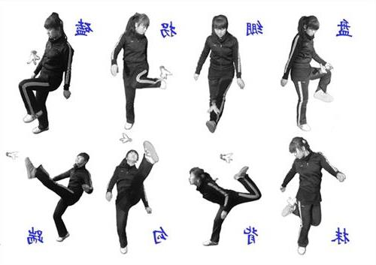
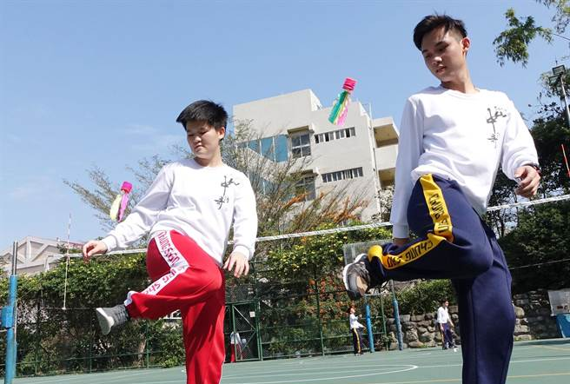
tī jiàn 踢毽子
汉代
2000多年前
鸡毛

