Slide 2
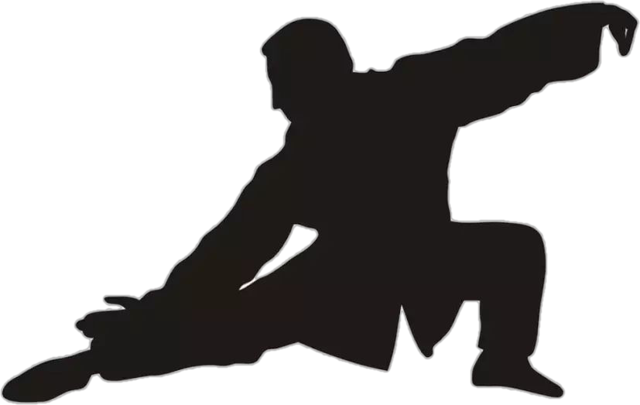
wǔ shù
武术（martial arts）
wǔ zhǐ ɡē wéi wǔ
武：（止戈为武） means stop fighting and wars
shù sī tōnɡ zào huà
术：（思通造化）flexible way of thinking
Chinese martial arts are fighting skills based on Chinese culture aims at fortifying one‘s health and stopping violence, it has a history of more than 4000 years, and forms an indispensable part of Chinese culture. There are around 129 different styles of martial arts, for example Tai Chi Chuan, Wing Chun, Shaolin Kungfu, Tantui(spring leg style)......

Slide 3
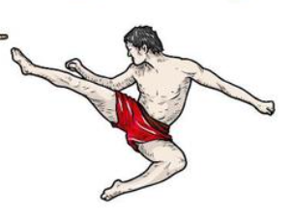
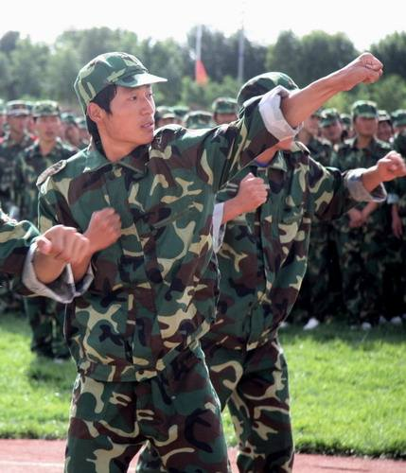
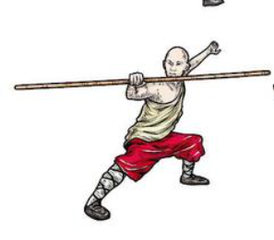
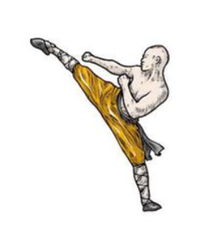
4000 years ago.
self-displine
self-defense
a form of art
Train soldiers

Slide 4
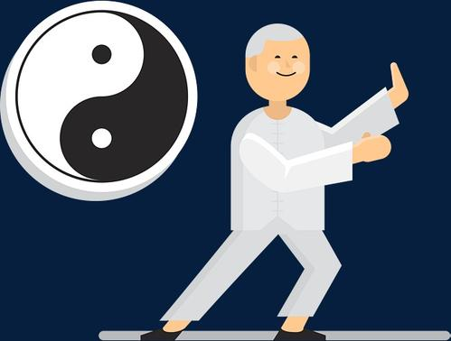
Two forms of 武术
external(quick & hard movements/exercise bones and skin)
internal(slow & soft movements/train your spirit)

Slide 5
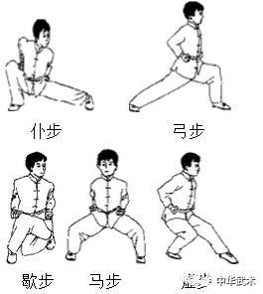
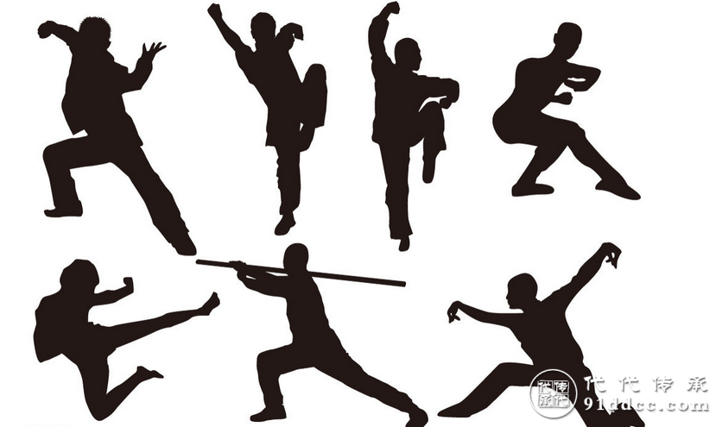

Slide 6
