Slide 1
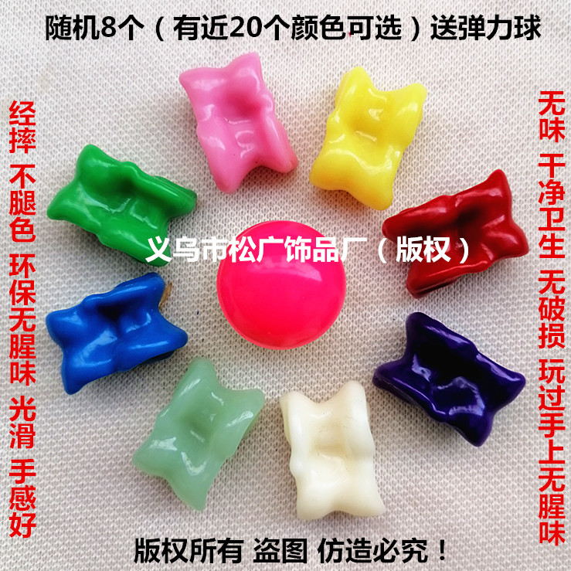
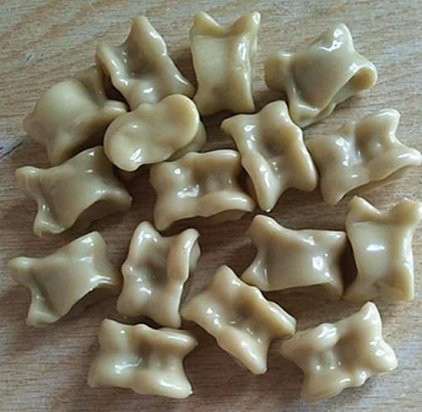
Yángguǎigǔ
羊拐骨（Man languague:gacuha）
Manchu traditional game
Round 800 years
To be agile enough to do embodiment

Slide 2
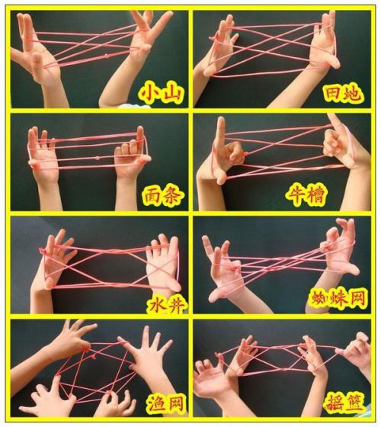
fānshéng 翻绳 Chinese rope weaving

Slide 3
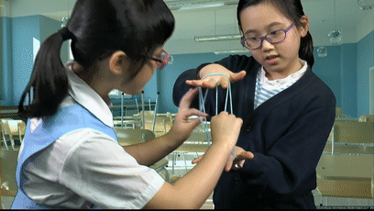

Slide 4
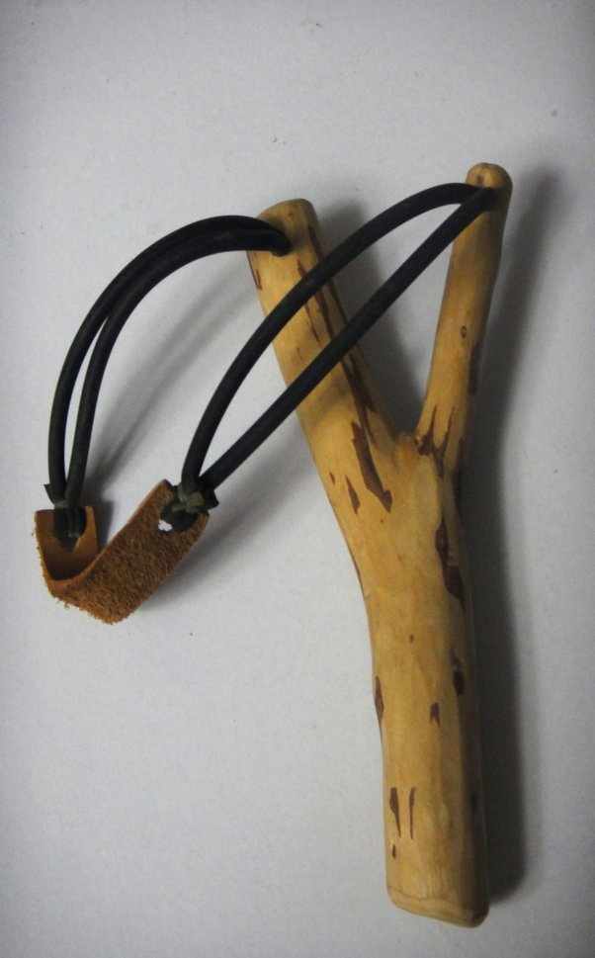
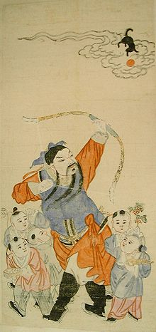
弹弓（pebble bow/slingshot）
Foklore-zhangxian-God of prosperity/offsprings
Popular in Qing dynasty

Slide 5
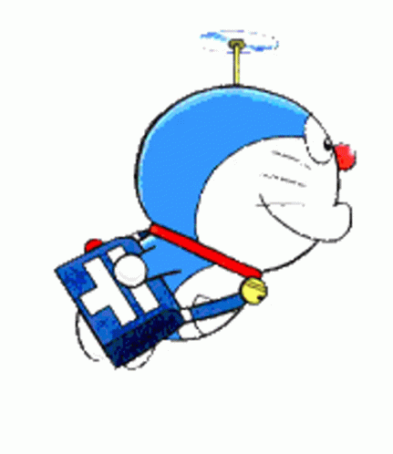
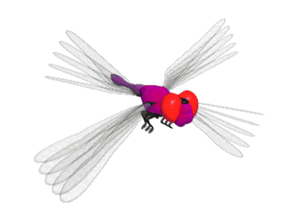
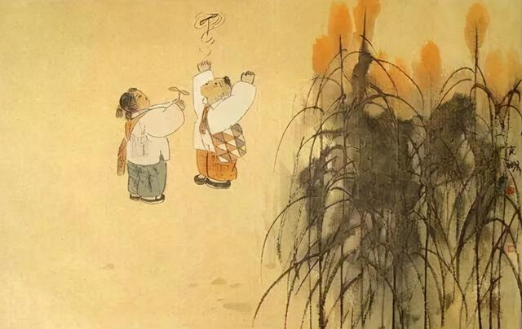
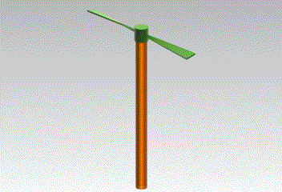
竹蜻蜓 bamboo dragonfly
Toy helicopter rotor
Flies up when its shaft is rapidly spins.
Originated in Jin dynasty around 320 AD.
and was the object of early experiments by English engineer George Cayley, the inventor of modern aeronautics.

Slide 6
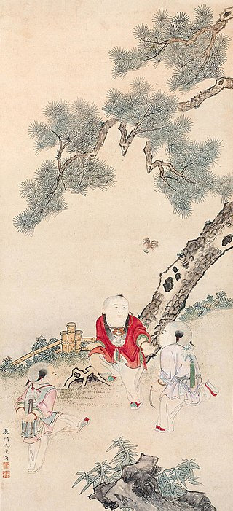
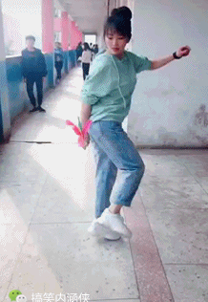
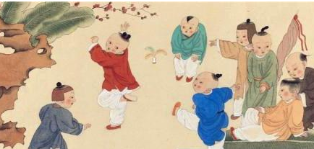
jiànzi 毽子（shuttlecock）
Originated in Shang dynasty,3000 years ago

