Slide 1
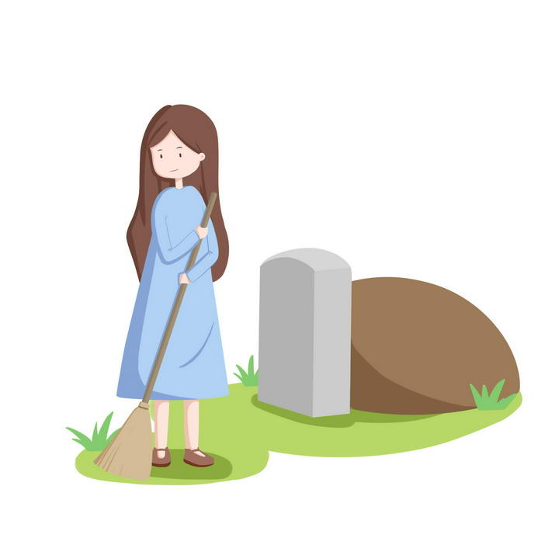
清明节

Slide 2
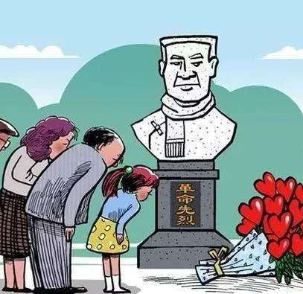
清明节
扫墓节
传统中国节日（Han Chinese and some of China’s 55 other ethnic minorities.）
sweep tombs and commemorate ancestors.
4月4日/5日
same day as Easter.
Zhou Dynasty (1046–221 BC), 2,500 多年历史

Slide 3
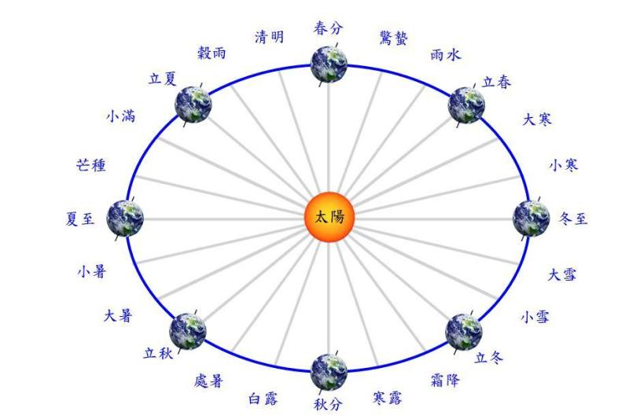
Originally, Qingming didn’t relate to tomb sweeping or showing respect to ancestors. It is the second of the 24 solar terms on the traditional Chinese solar calendar.

Slide 4
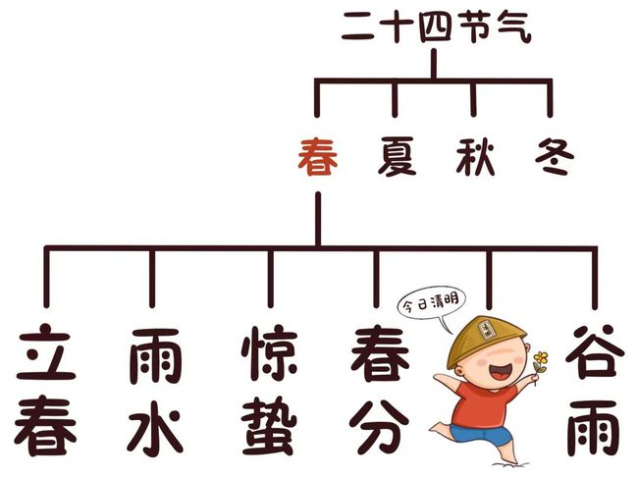
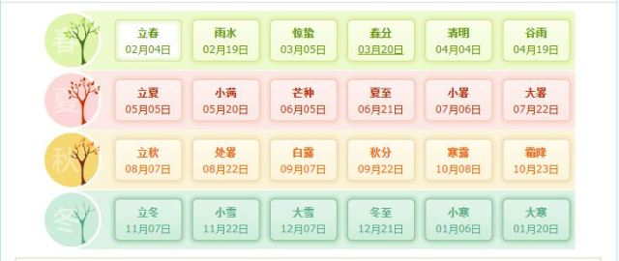

Slide 5
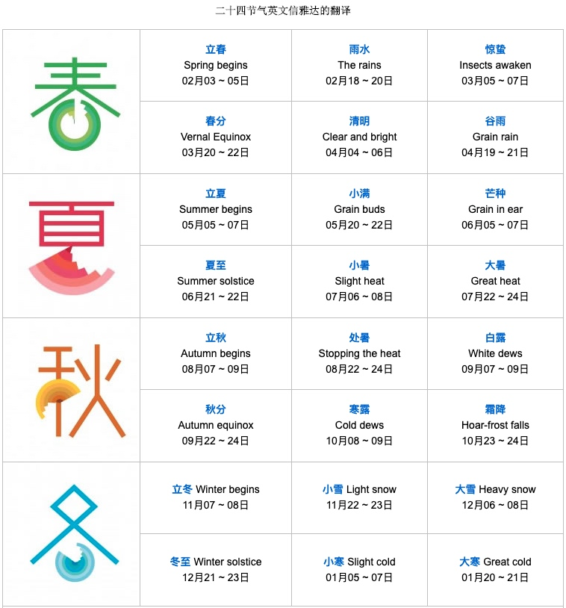

Slide 6
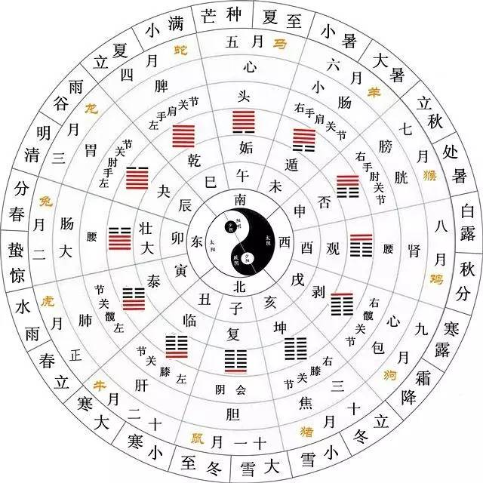

Slide 7
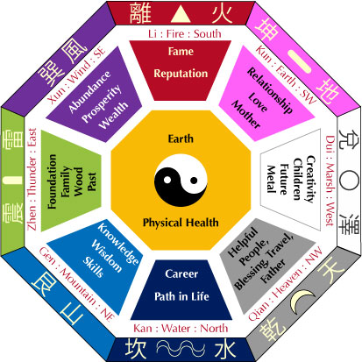

Slide 8
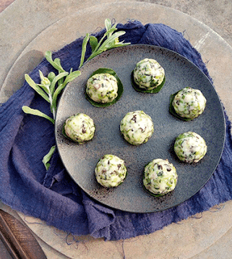
清明 - clearness and brightness
climate and nature-warmer & brighter
清明节的前一天-寒食节（cold food day）-no fire, only cold food
Gradually combined into one

Slide 9
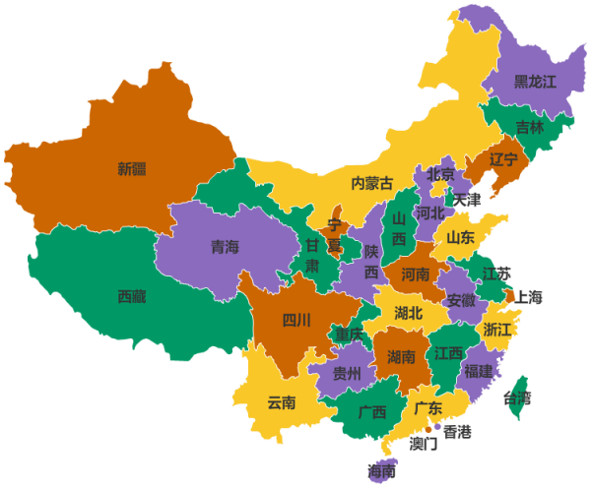
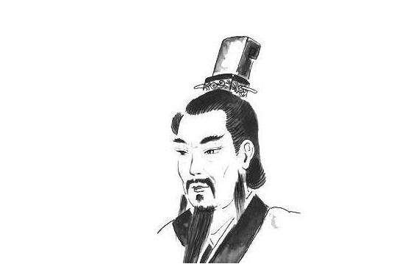
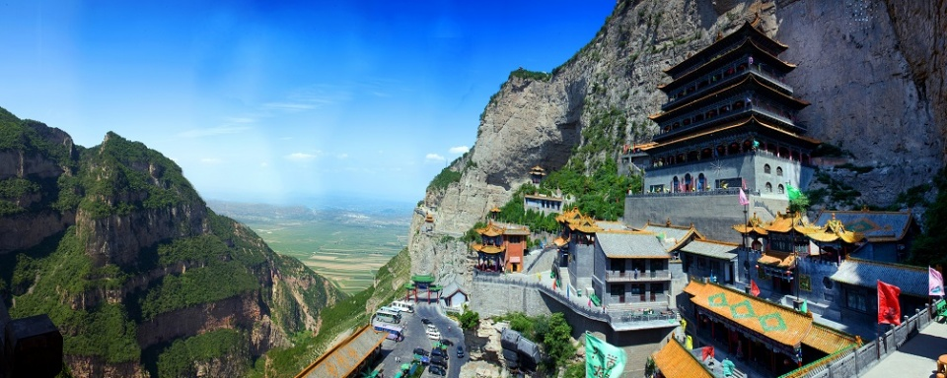
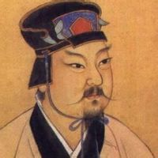
山西
Mianshan - Jieshan (‘Jie Mountain’)
Jie Zitui (?–636 BC)-a loyal defender of Duke Wen of Jin (697–628 BC), who, earlier in life, was a prince in exile named Chong 'er.

Slide 10
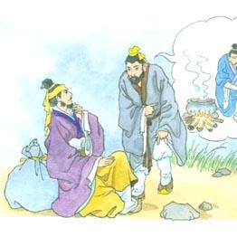
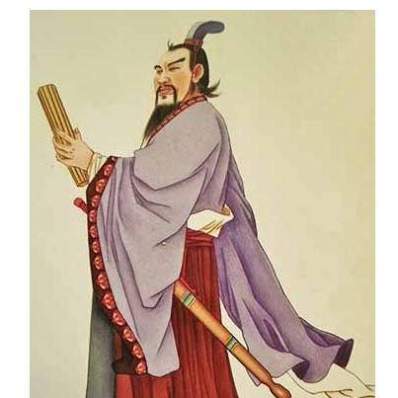
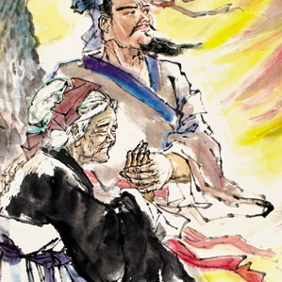
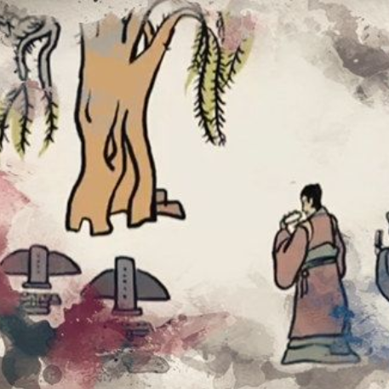
Back to 655 BC, Chong'er was about to starve to death
Jie Zitui-a piece of flesh.
Chong'er promised to reward him one day.
Nineteen years later, Chong'er returned to his kingdom
he forgot Jie Zitui, the man who once saved his life. When others spoke of Jie Zitui, Duke Wen remembered him and was ashamed.
visit Jie Zitui personally and confer a title on him.
hid on a nearby mountain with his aged mother.
Duke Wen set fire to the mountain to force Jie Zitui out of hiding.
Three days later, the duke and his people found two dead in a cave under a willow tree.
not to use fire and only to eat cold food on that day.
The next year, burnt willow tree was revived. He swept the tomb and declared the festival as a “Cold Food Festival”

Slide 11
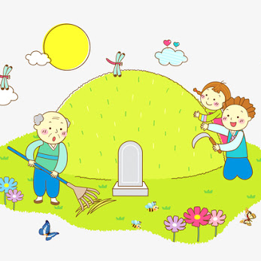
清明节活动
tomb cleaning and repair
春游 （spring outings）
放风筝 （kite flying）
putting willow branches on gates
People often participate in a sport to ward off the coldness and in anticipation of the arrival of spring.

Slide 12
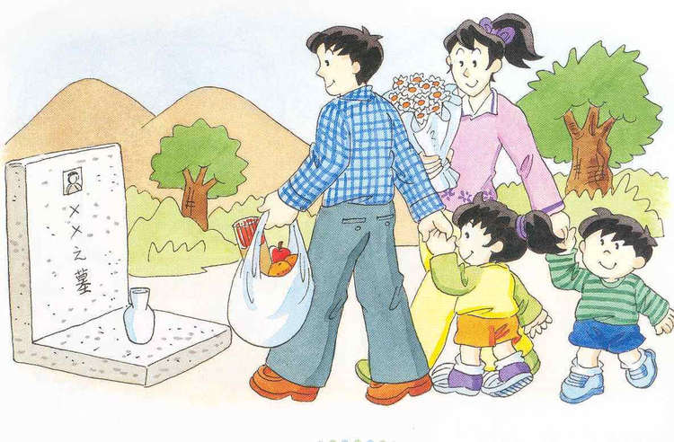
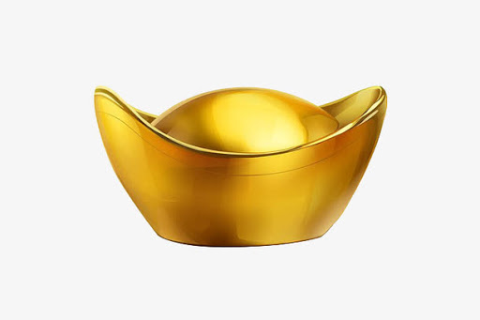
Tomb Sweeping — the Most Important Custom of 清明节
commemorate and show respect to ancestors by visiting their graves, offering food, tea or wine, burning incense, burning or offering joss paper.
sweep the tombs, remove weeds, add fresh soil to the graves.
stick willow branches, flowers, or plastic plants on the tomb.

Slide 13
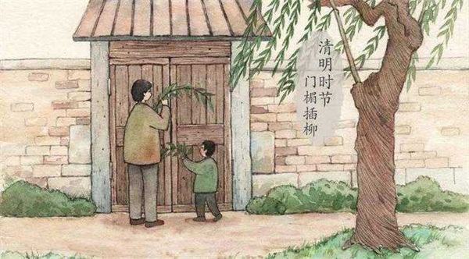
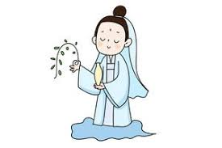
Putting Willow Branches on Gates
ward off wandering evil spirits during 清明节.
Buddhist influence
Mercy Guanyin -a willow branch in a vase of water at her side to scare away demons.

Slide 14
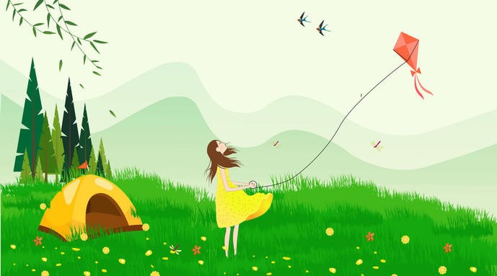
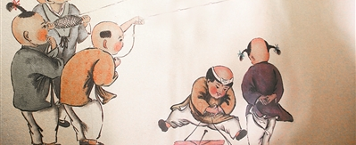
放风筝 is also an important custom enjoyed by many people, young and old, 清明节.

Slide 15
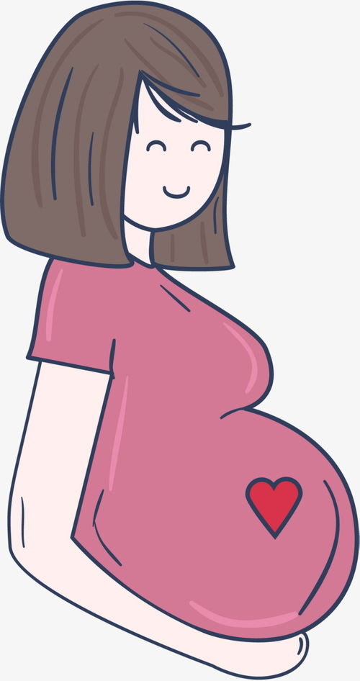
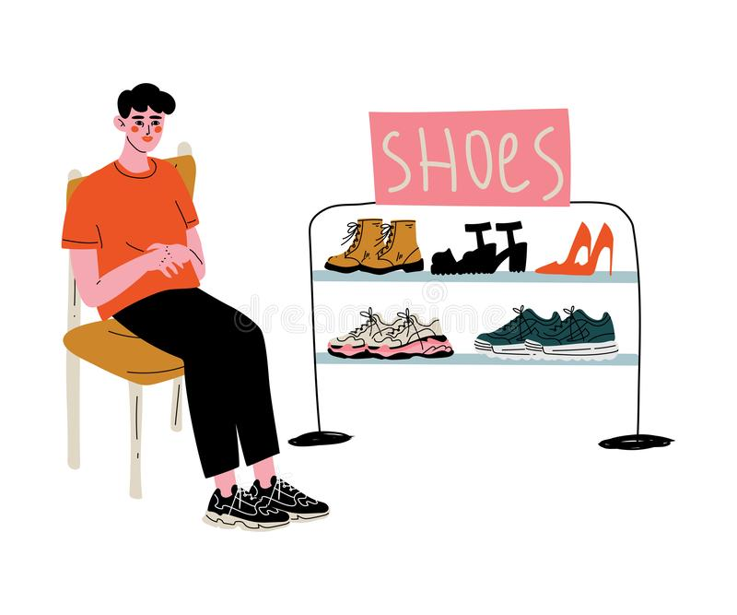
jìn jì 禁忌 taboos
孕妇不可以去扫墓（拥挤、墓地环境不好）
不可以拍照（不尊重、厄运）
头发不可以遮住额头
不可以买鞋 （xié）-邪

Slide 16
